Slide 1
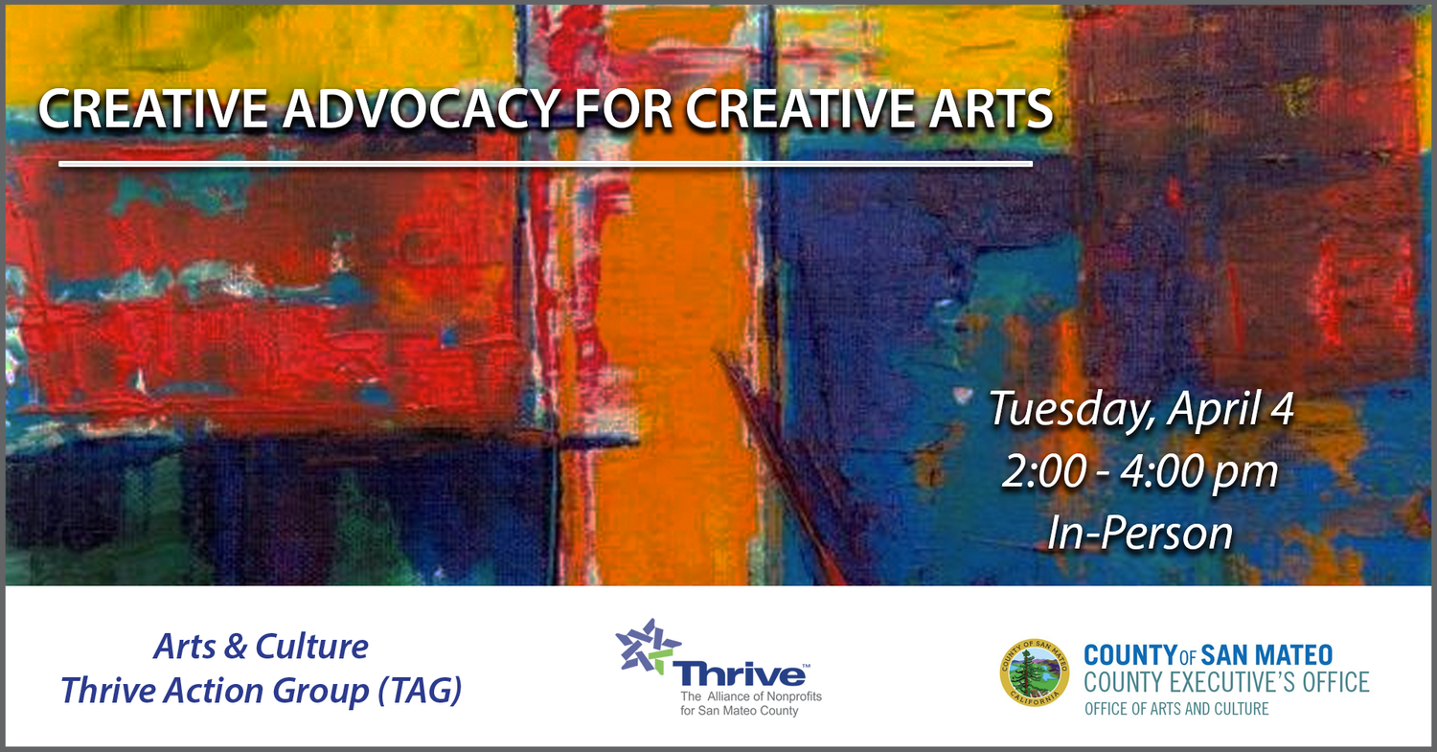
76 People Clicked On the Email

Slide 2

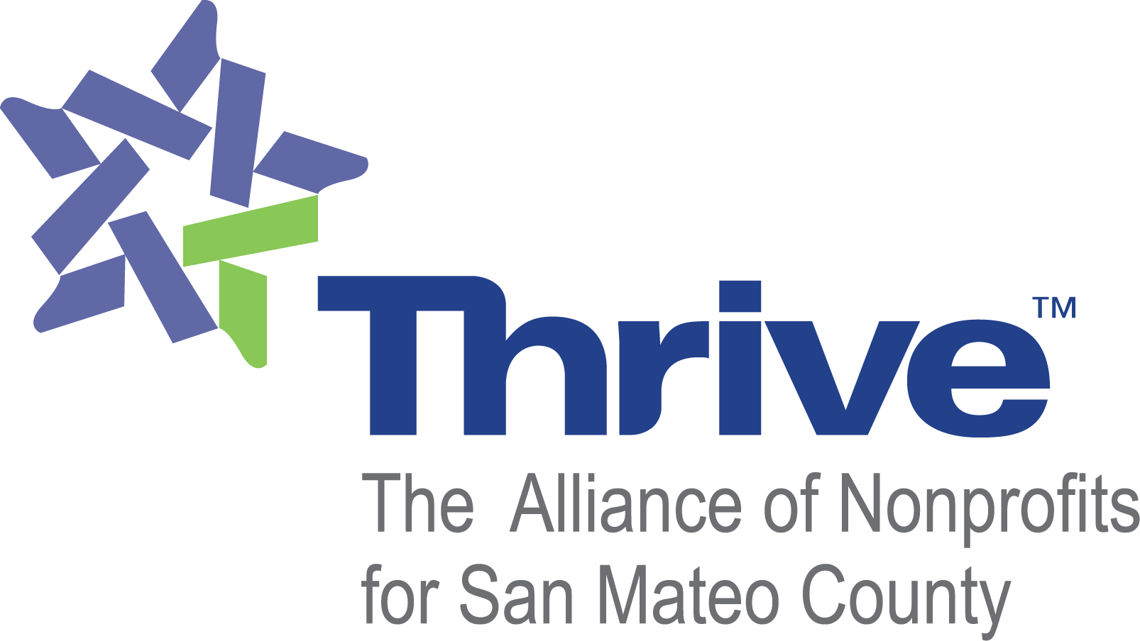
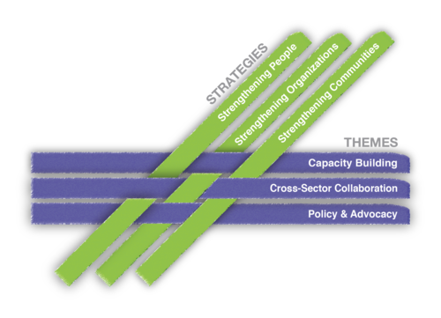
Notes:
We focus on 3 main strategies that interweave throughout our programs: Strengthening People. Strengthening Organizations, Strengthening Communities
Our 3 themes also include Capacity Building, Cross-Sector Collaboration, Policy & Advocacy

Slide 3

76 People Clicked On the Email

Slide 4
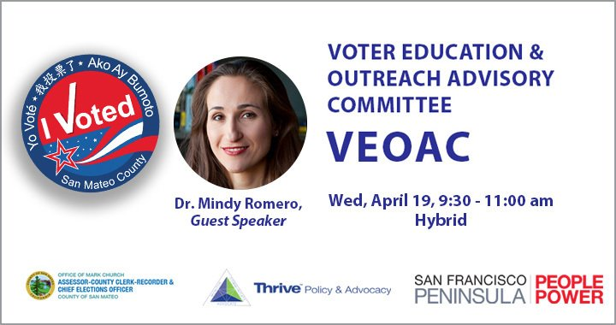
76 People Clicked On the Email

Slide 5
76 People Clicked On the Email

Slide 6
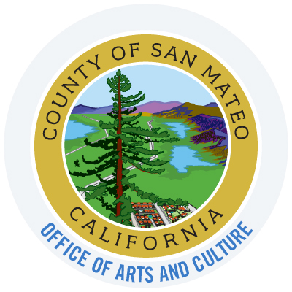
GOVERNMENT ADVOCACY

Slide 7
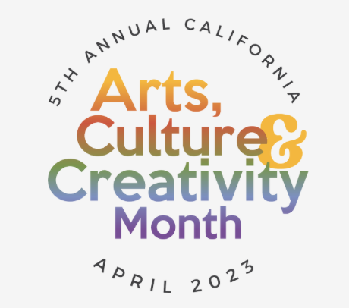
ACCM!
Arts/Culture/Creativity Month
LOBBY for legislation and state funding
General ADVOCACY for arts/culture/creativity
County art agencies are also coordinating local meetings
with Electeds – SEE ME!
TUESDAY, APRIL 18, CAPITAL BUILDING
AFTERNOON: Celebration at the Capital on
Capital Park (lawn)
MORNING: advocacy appointments with your Electeds.

Slide 8
OAC ADVOCACY: It’s a Year Round Gig!
OFFICE OF ARTS AND CULTURE (OAC)
Shares info on the creative sector and economy with Supervisors and County Executives
Participates in advocacy trainings and events hosted by the Cal Arts Council (CAC state arts agency) and Californians for the Arts (CFTA)
Advocate to the County and State Electeds for budgetary and programmatic support for our Creative Sector
COMMISSIONERS
Regularly provide info/feedback on activities in their district, and for funding
Promote Commission and OAC work and opportunities
Meet with Electeds during ACCM!
OAC and AC
Ambassadors of our Creative Sector throughout the County
Showcase our Creative sector at our annual celebration of the arts/culture – SEE YOU IN OCTOBER!

Slide 9
GET INVOLVED!
CONNECT WITH YOUR ELECTEDS at all levels:
Share your “hits” via email or letter
Make requests of them – ask them to speak at an event, send them an invitation to an event or program
Add them to your e-news/flyers lists.
The more you keep in touch and share your activities,
the more they will remember you when you when you make a request.
START AN ARTS ADVOCACY AGENCY (501c3 or Fiscally Sponsored), i.e.:
San Jose Arts Advocates
Redwood City Arts
JOIN CALIFORNIANS FOR THE ARTS! An inexpensive membership that offers free “how to”
strategies, and latest info on legislation.
CORPORATIONS, SMALL BUSINESSES, LOCAL PHILANTHROPISTS
Use your organization’s staff and board’s networks to seek them out, and ask for their support – financially or otherwise.

Slide 10
TIPS AND TRICKS TO SUCCESSFUL ADVOCACY WITH ELECTEDS
HOMEWORK
Find out on which committees the Elected serves (on their website): are they committees with connections to arts/culture and the creativity economy? If so, great…
If not, make the connection for them. I.e., Travel industry relies on arts and culture to provide creative and cultural destinations; educational institutions rely on arts/culture ed teachers.
Data and statistics are available on the bi-annual Otis Report on the Creative Economy
Prepare stories: stats are great, particularly when it comes to dollars for A/C – but personal stories about people and organizations in their district are extremely.
Keep your ask to 1 or 2.
Unless you are well acquainted with the Elected, you are likely to be scheduled to meet with a Legislative Aid or District Director.
It is standard practice. It is a bonus if you meet the Elected personally.
Be ready with stats and stories.
FOLLOW UP:
Follow up with a thank you LETTER (not email, not card)
Keep in touch!

Slide 11
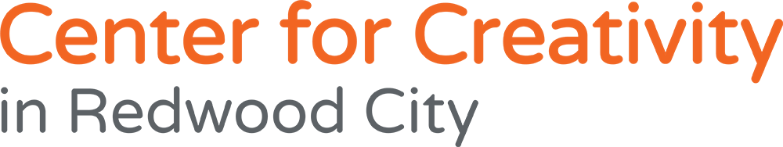
Kent Manske
Susie Peyton
rwccfc.org

Slide 12
2012 2019 2020 2021 2022 2023

Slide 13
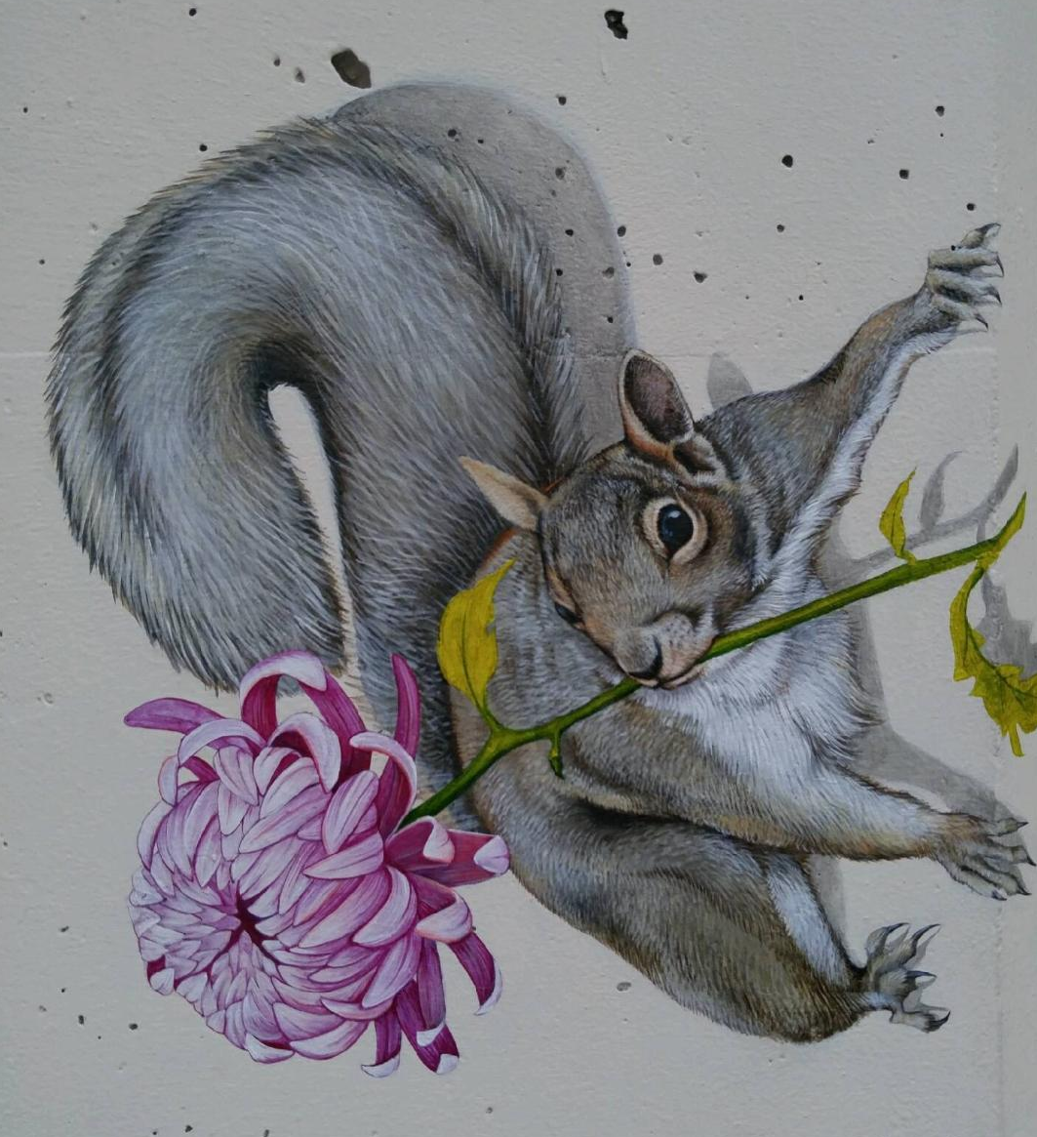
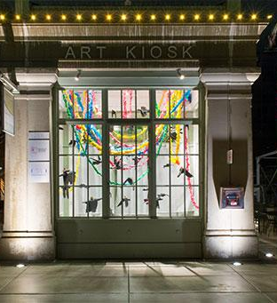
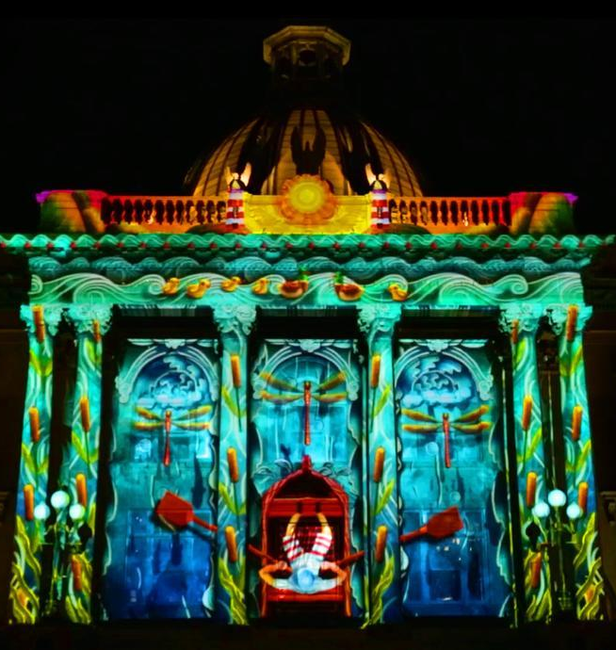
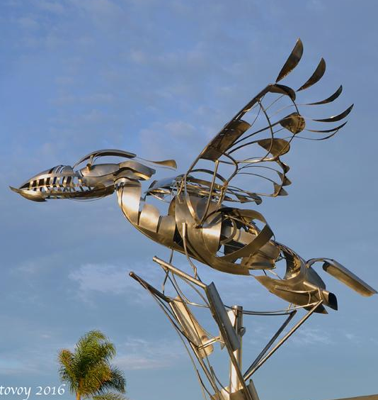
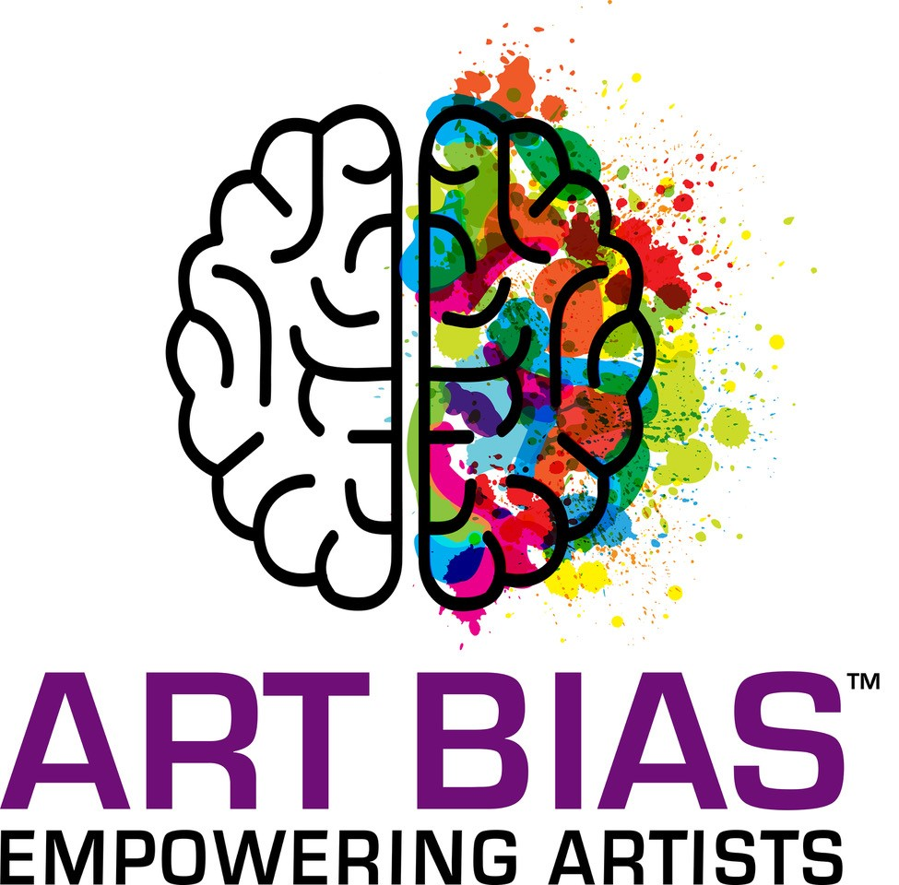
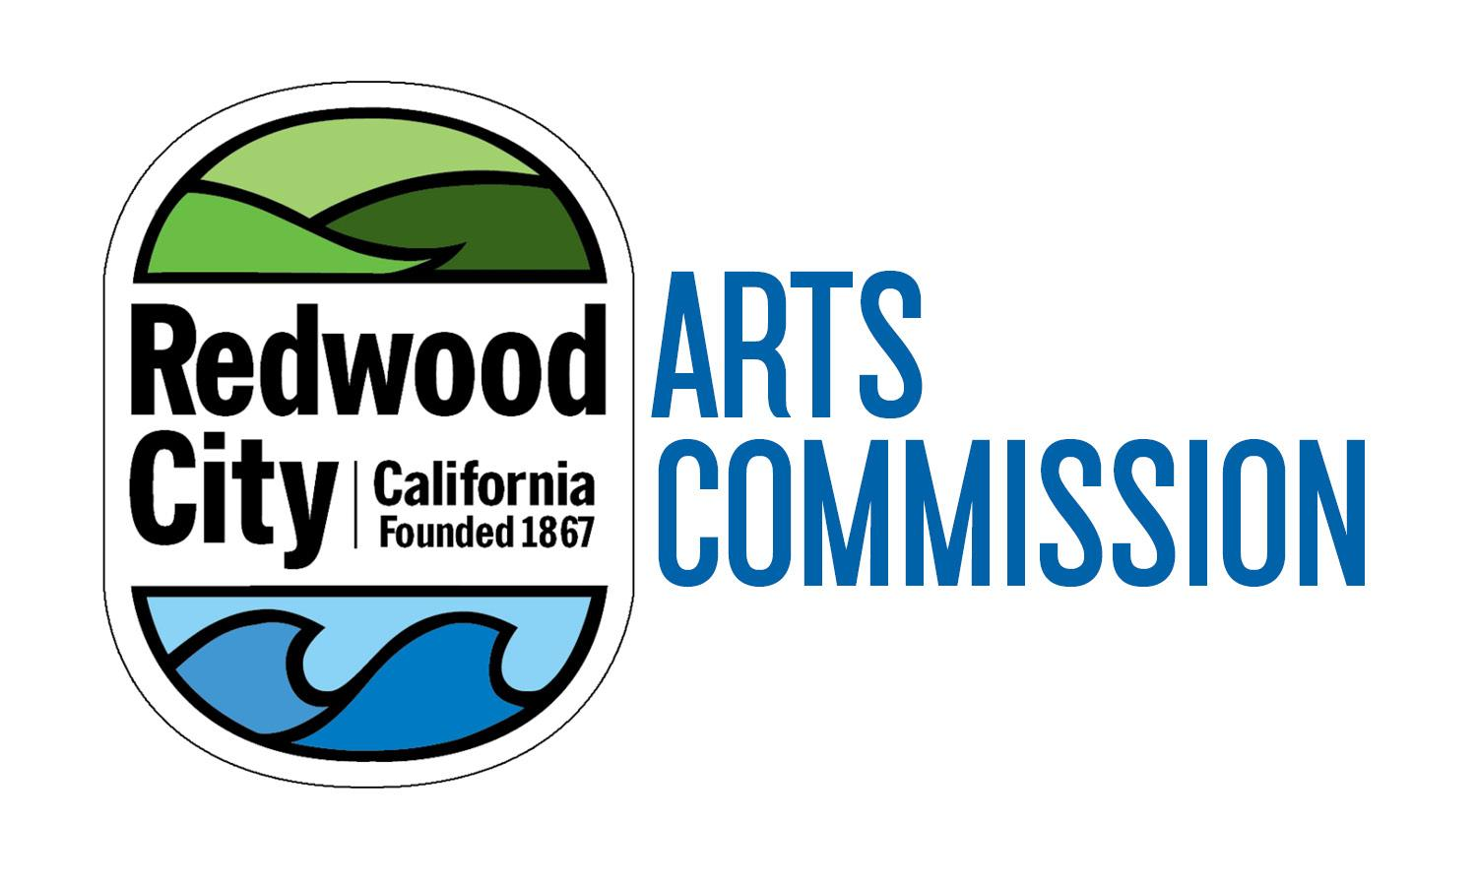

Center for Creativity Vision and Opportunity in Redwood City
Presented by Redwood City Parks & Arts Foundation, Art Bias, the Redwood City Arts Commission in collaboration with ARTS RWC
1 January 2021
Notes:
Add Arts Commission logo and new foundation logo and Art Bias logo
Update date

Slide 14
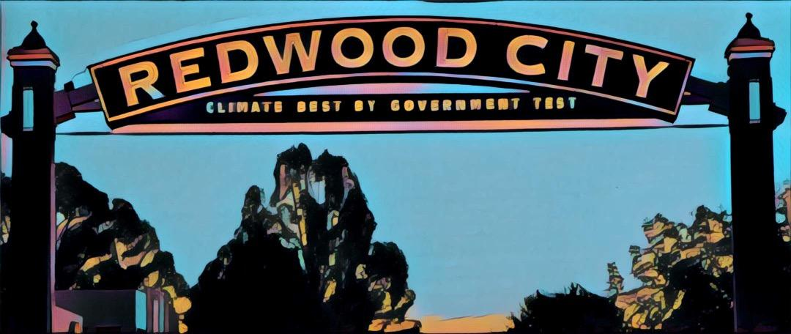
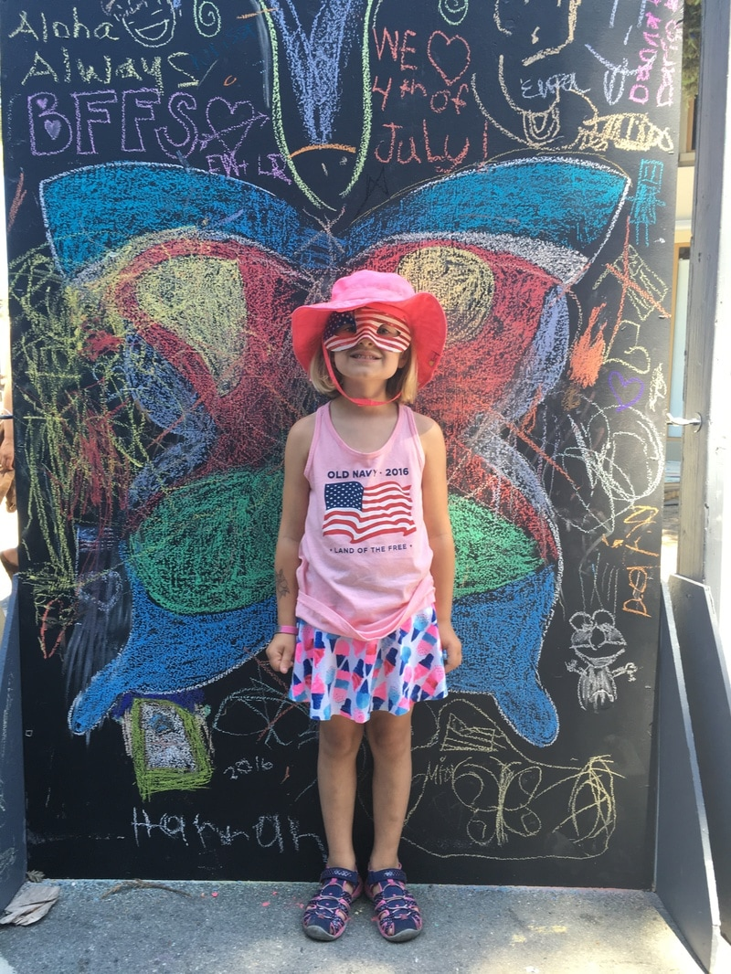

History
Redwood City is an entertainment destination and strives to become The Premiere Arts, Culture, and Entertainment Destination on the Peninsula by fostering a thriving arts community that brings creative opportunities for all ages to experience and enjoy.
Recent history:
1993 - The Redwood City Art Center (now known as Art Bias) was founded as artist studio space in downtown Redwood City, in 2015 it had to move to San Carlos where it currently provides studios for over 50 artists
2006 - The City supported the launch of ART on the Square
2008 - The City supported the downtown Phantom Galleries
2010 - ARTS RWC was formed, this is a collaborative forum of artists, art advocates and all those interested in the arts
2012 - The Redwood City Parks and Arts Foundation was founded
2014 - Utility Box Mural Pilot program launched and followed by many other public art projects (murals, sculptures, shadow art and more)
2016 - The City passed the Percent for Art Ordinance
2018 - The City created the Public Arts Master Vision and changed the name of the Civics Cultural Commission to the Arts Commission

Slide 15

Vision
MISSION: To be a catalyst for creative exploration and community engagement. To have a Center for Creativity where artists in all spheres create art, perform art, engage with the community and provide art education and enrichment.
VALUES:
Embrace cultural and generational diversity, technological innovation, and community interaction and dialogue
Encourage creativity for all ages
FACETS OF THE ARTS CENTER: The Center for Creativity will be a reconfigurable, flexible, and multi-use space that will maximize the usability and impact of every square foot. This private/public partnership will include:
Arts instruction and mentoring
Participatory creative experiences for all ages
Art exhibitions, cultural performances, lectures and workshops featuring local and international artists
Studio/performance spaces with shared resources for working artists and non-profits
Cafe, arts-oriented retail and outdoor spaces
To realize this vision, Redwood City needs a permanent facility dedicated to house and program the arts. Analogous art centers elsewhere are typically 30,000-40,000 sf with classroom, studio, exhibition, theater, and retail space.
A PLACE
FOR ALL TO
CREATE,
LEARN,
AND
ENJOY!
Notes:
To realize this vision, Redwood City needs a 60,000 sq. ft. permanent arts space for every facet of our ideal arts center to become a reality.

Slide 16

Where we are today
Arts education within public schools has been severely cut since Proposition 13 in 1978
Arts of all kinds - visual, music, performance, and more - are disappearing because the costs of living and running arts businesses are unsustainable in the Bay Area
Galleries, artist studios, and community theater groups have been forced to reduce programs, close doors, or move to more affordable areas
These ongoing losses are reducing cultural richness and economic value in Redwood City and the region.

Slide 17

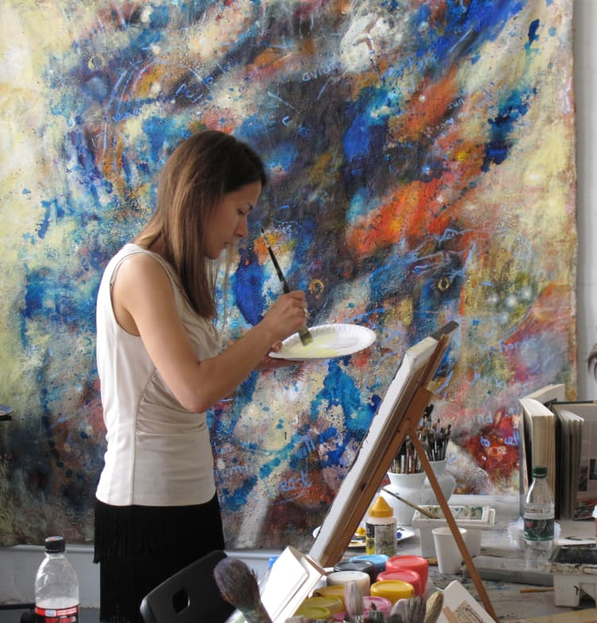
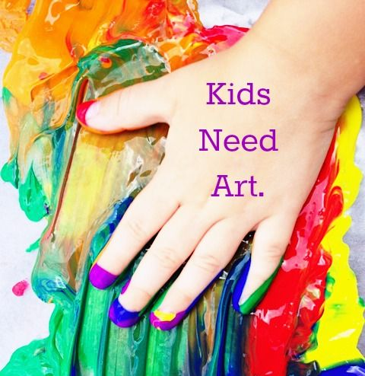
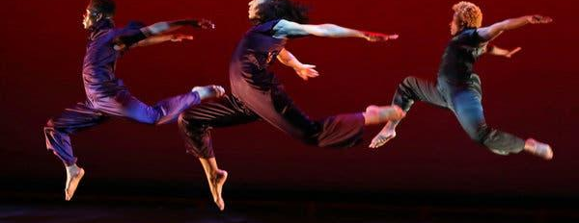
Addressing the Needs
A R T S
The Center for Creativity would address numerous critical needs in Redwood City and the region:
Supplement arts education and creative experiences
Provide families and community members ready access to view, learn, create and experience art
Support working artists in both traditional and innovative contemporary disciplines by having access to affordable studio, exhibition, practice and performance spaces, as well as professional development programs to assist them creatively and financially
Be THE resource center for all arts and cultural activities, events, performances and opportunities in Redwood City and the peninsula

Slide 18
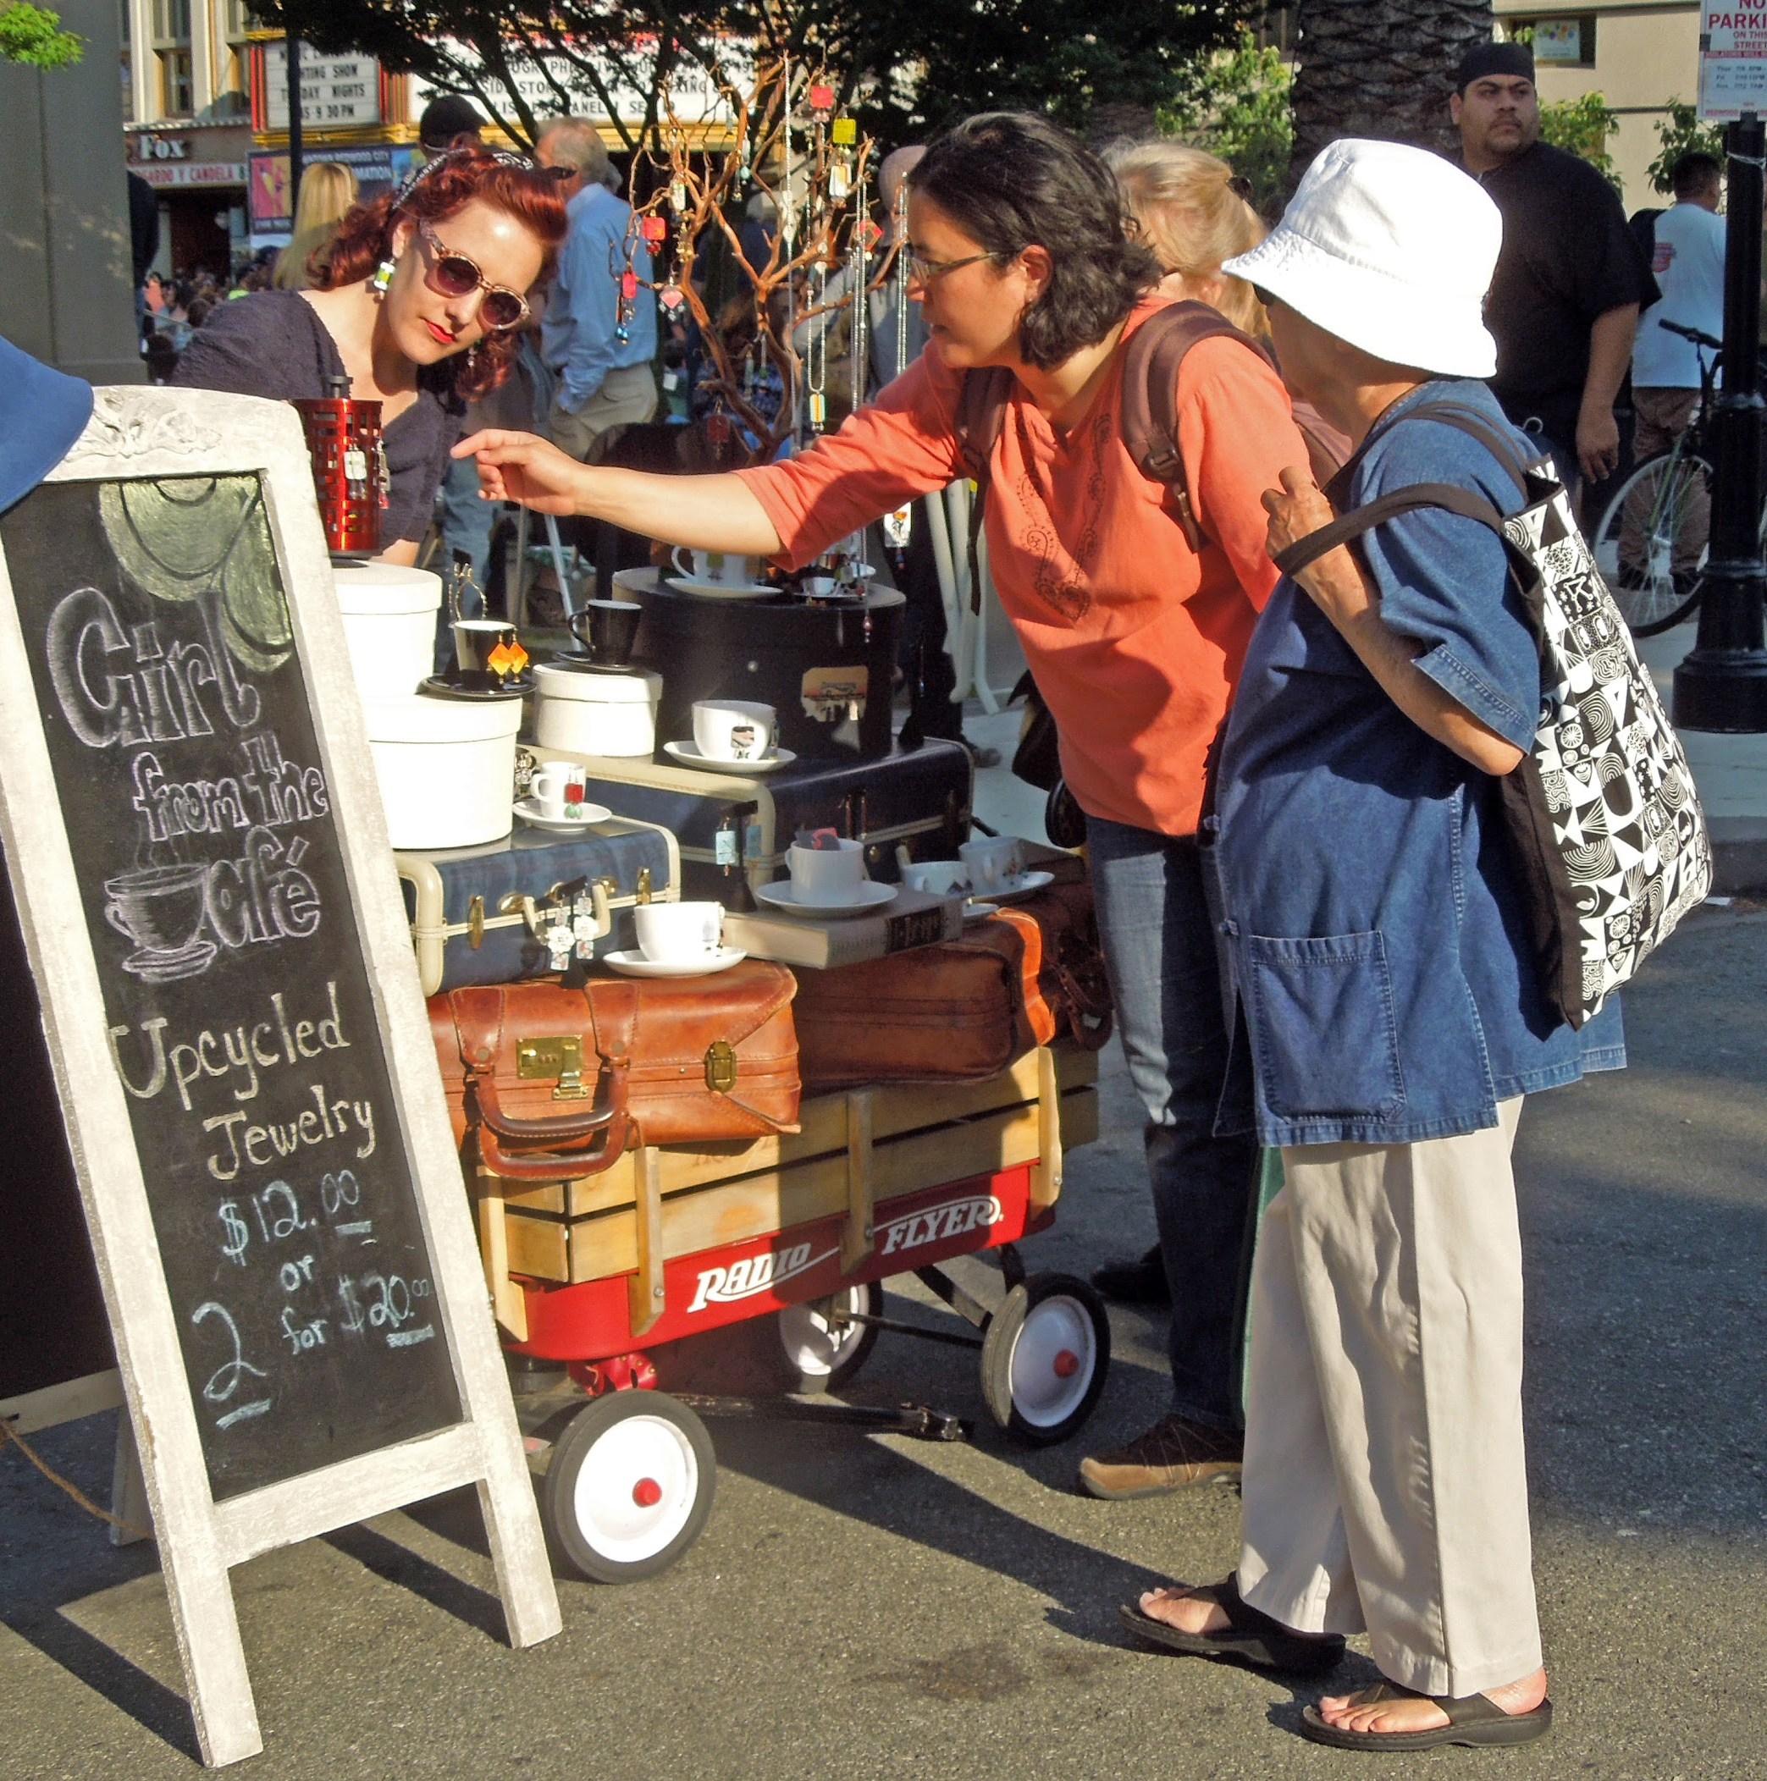
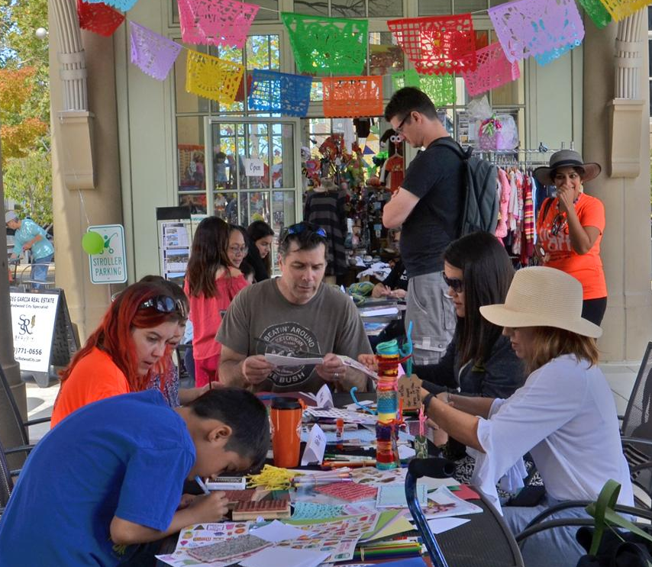
Benefits
A permanent home for the arts in Redwood City that makes the arts accessible to everyone and maintains affordable costs for all will benefit the area both culturally and economically.
It would truly position Redwood City as The Arts, Culture, and Entertainment Destination on the Peninsula, making it a rich and lively cultural destination by:
Enriching the education of the city’s children
Boosting local businesses
Instilling pride and community cohesion
Facilitating lifelong learning
Encouraging civic dialogue
Engaging families and citizens
Increasing tourism
Notes:
Not sure that sentence sounds right, creatives as a noun?
Perhaps the sentence can be reworded, example:
A Center for Creativity in Redwood City, that makes the arts accessible to everyone and maintains affordable costs for all levels of creative individuals, benefits the area both culturally and economically.

Slide 19
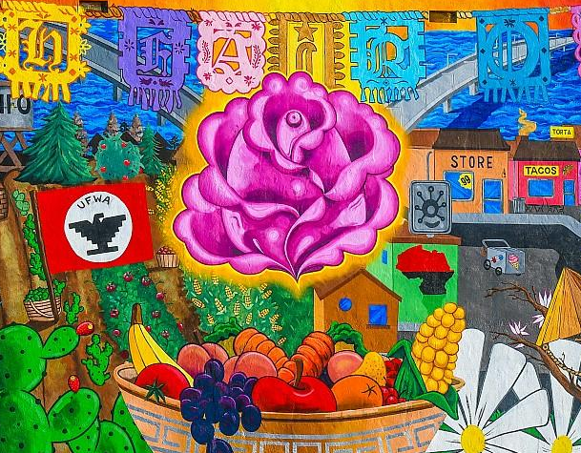
Art Improves Civic Life
*Each of the 26 topics has extensive data and fact sheets at the Arts + Social Impact Explorer. Explore all the topics to fully understand how and why the arts are a crucial element of a thriving community.
Americans for the Arts research demonstrates why art is significant for local economic development and community health. Visit Arts + Social Impact Explorer for more data.
ARTS + ECONOMIC DEVELOPMENT
Arts generate 4.2% of U.S. GDP
Arts support 4.92 million jobs in the U.S.
53% of businesses value arts partnerships
ARTS + TOURISM
68% of tourism in U.S. is driven by art
Cultural tourists spend 2X more
68% increase in empathy for other cultures
80% of people explore new places for the arts
ARTS + HOUSING
20% rise in property values
Arts raise awareness
More art = more value

Slide 20
Art Improves Civic Life - cont.
ARTS + LIFELONG LEARNING & YOUTH EDUCATION
$1 for after school art programs save $9 on other costs
2X as likely to graduate college
100 points higher on their SAT
4 out of 5 more likely to vote
9 out of 10 say arts increase connection to community
40% more likely to have friends from different racial groups
IQ increased by music training in 3-5 year olds
63% reduction in risk of dementia
ARTS + COMMUNITY DEVELOPMENT & COHESION
86% of arts participants more involved in civic issues
40% feel more positive about their community after taking part in the arts
Arts-rich neighborhoods 1.6X more connected
Arts participation unites generations, reduces fear, and empowers citizens
ARTS + IMMIGRATION
85% strengthen community ties
57% believe american culture improved by immigrant cultures
Culture improves immigrants’ well-being

Slide 21
Examples of Successful Local Arts Centers
Other local communities have established arts centers that enhance the urban environment, foster community, and serve a city’s population, including:
PACIFICA Sanchez Art Center A private/public partnership Pop. 39,000 Founded: 1998 Sq. Ft. 39,000 Amenities: - Artist studio rentals - Exhibition space - Education and outreach programs - Community events - Rentable space
PALO ALTO Palo Alto Art Center A private/public partnership Pop. 67,000 Founded: 1971 Sq. Ft. 28,000 Amenities: - Art classes for all ages
- Exhibition space - School tours - Gallery Shop - Community events - Rentable space
WALNUT CREEK Center for Community Arts A private/public partnership Pop. 69,000 Founded: 1964 Amenities:
- Art, music, dance and theater classes for all ages - Exhibition space - Preschool and kid camps - Community events and performances
RICHMOND Richmond Art Center A 501c3 nonprofit Pop. 110,000 Founded: 1936 Sq. Ft. 25,000 Amenities: - Art classes for all ages
- Exhibition space - Open studio space - Professional development for educators - Community events - Rentable space
EAST PALO ALTO East Palo Alto Arts Center Private project that will become a 501c3 Pop. 30,000 Groundbreaking: 2018 Sq. Ft. 21,000 Amenities: - A youth focused art, design and music center - Exhibition space - A theatre & recording studio - Flexible community space - Cafe
Our vision for the Center for Creativity includes all the highlighted amenities..

Slide 22
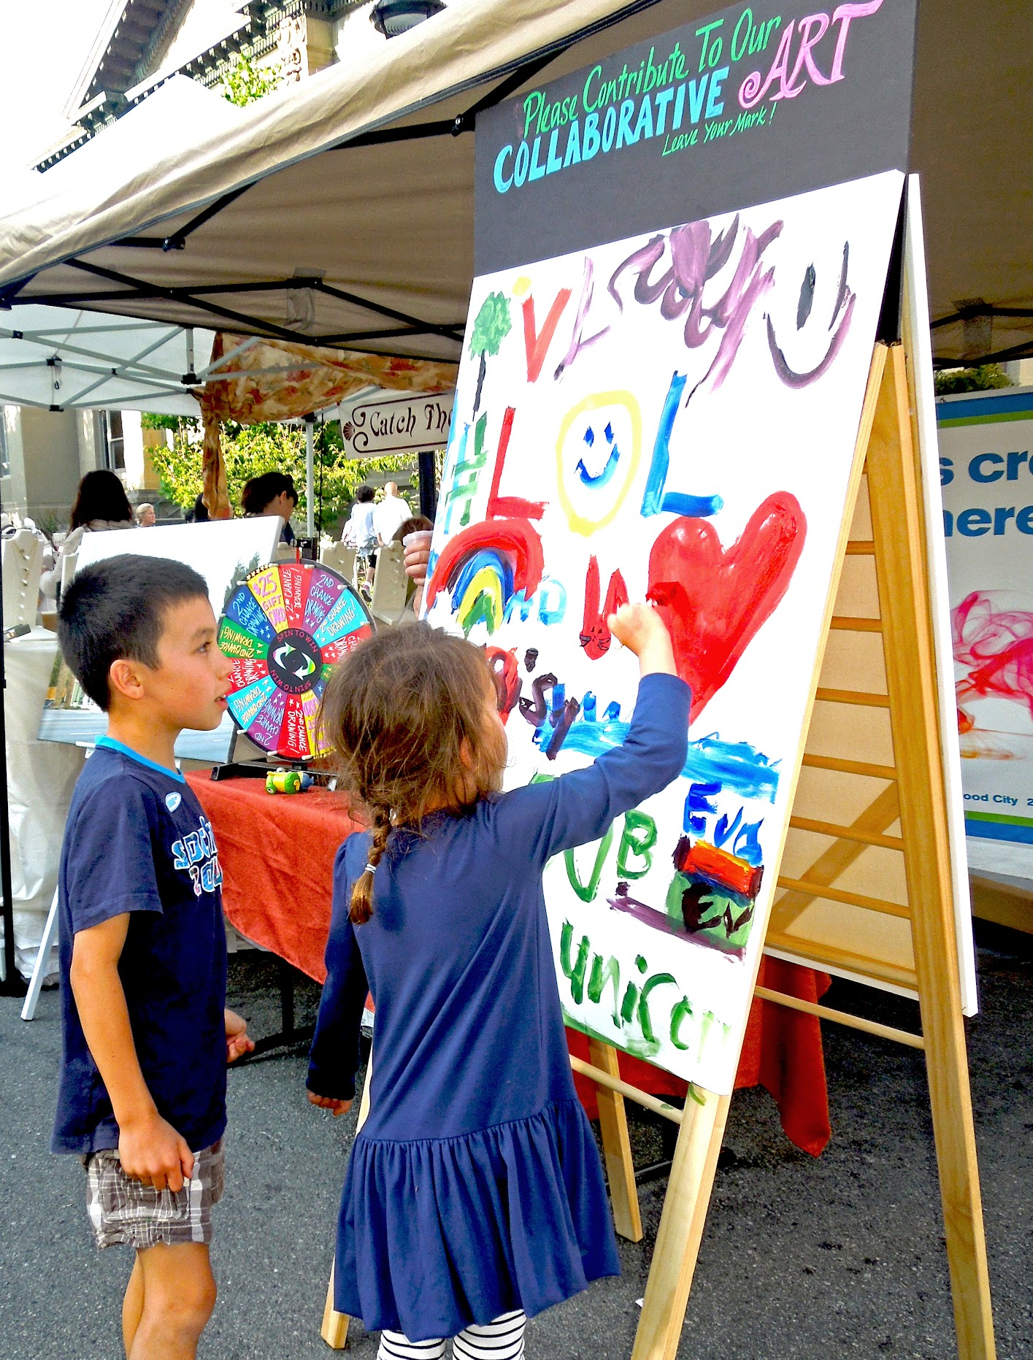
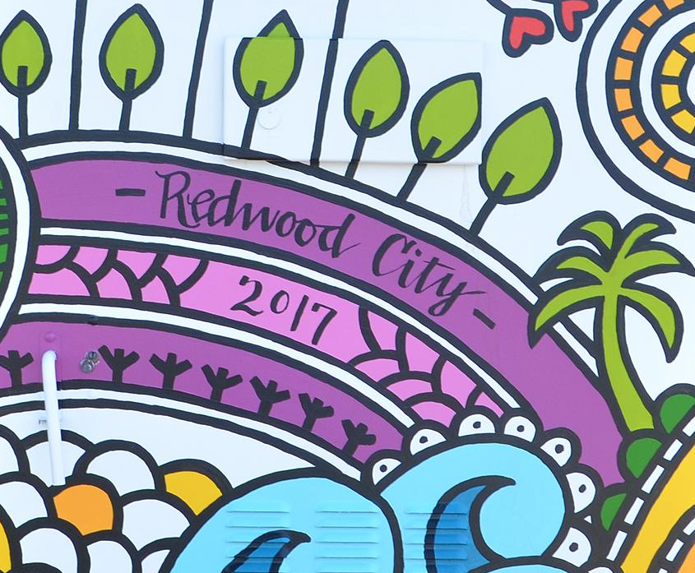
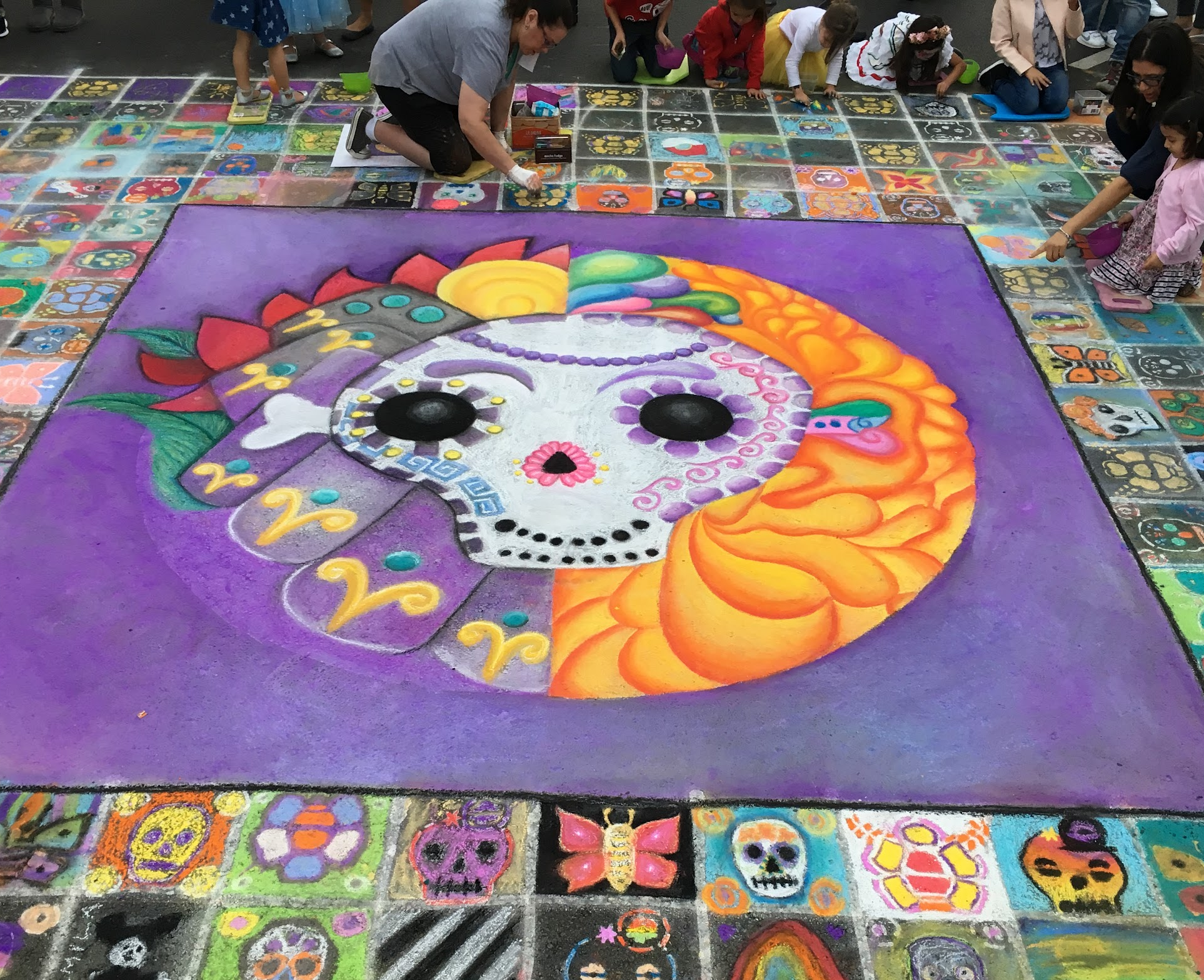
We ask for your support for this vision for a Center for Creativity in Redwood City. The broad cultural, economic, health, and civic impacts it would have on the community - for both children and adults alike - argues for its inclusion as a community benefit that developers could include in their projects.
Notes:
I added the text above by combining several other versions, edit at will.

Slide 23
2012 2019 2020 2021 2022 2023

Slide 24
2012 2019 2020 2021 2022 2023

Slide 25
2012 2019 2020 2021 2022 2023

Slide 26
2012 2019 2020 2021 2022 2023

Slide 27
2012 2019 2020 2021 2022 2023

Slide 28
2012 2019 2020 2021 2022 2023

