Slide 1



COVID-19 Community Focus Groups
April 1, 2019

Slide 2
Agenda
NEXT STEPS
Welcome
Goals and Purpose
Overview of Health Data
COVID-19 Strategies and Priorities
Bridging the Gap
Next Steps
Notes:
On behalf of San Mateo County Health, COVID-19 Response Unit, Health Equity Team, Office of Community Affairs, and Thrive Alliance, welcome!

Slide 3
Goals and Purpose
NEXT STEPS
GOAL: How do we work together to bridge the vaccination gap?
PURPOSE: Get community input on strategies for specific populations and age groups from the people that serve them Black/African Americans, Native Hawaiian/Pacific Islanders, youth (0-11 yrs) and the 65+ population.
HOW:
Evaluate what worked and didn’t work on previous outreach
Collect new ideas
Review what resources are needed to be effective
Input gathered today will help inform future strategies and funding opportunities.
Pillars: Access, Literacy, Trust

Slide 4
NEXT STEPS
Overview of Health Data
Trish Erwin, PhD
Manager, COVID-19 RESPONSE UNIT/SMC IMMUNIZATION BRANCH

Slide 5
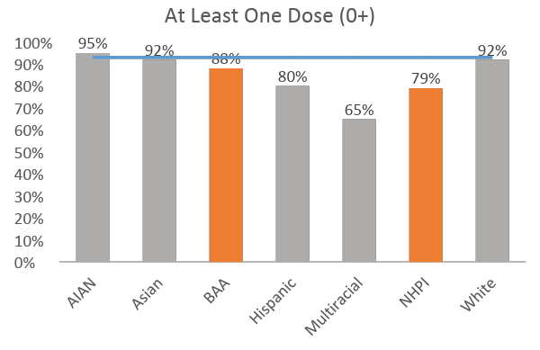
COVID-19 vaccination rates for SMC
At Least One Dose rates are high for all County (0+)
BAA and NHPI are below County
>
County: 93%
Data caveats
Bivalent booster data not included
Rates are capped at 95% due to limitations in data precision
Some vaccination records are missing race/ethnicity information
As of 9/29/2022. Bivalent boosters not included.

Slide 6
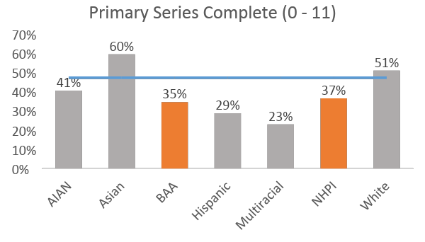
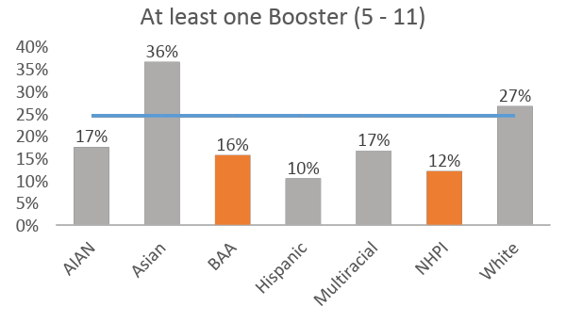
Vaccination rates for 0-11 year-olds
County: 48%
Primary Series Complete rates are low for all County 0 – 11
BAA and NHPI are below County
Booster rates are extremely low for all County 5 – 11
BAA and NHPI are below County
County: 24%
As of 9/29/2022. Bivalent boosters not included.

Slide 7
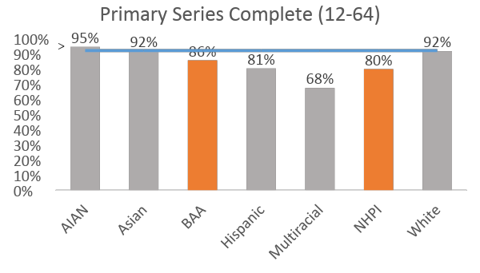
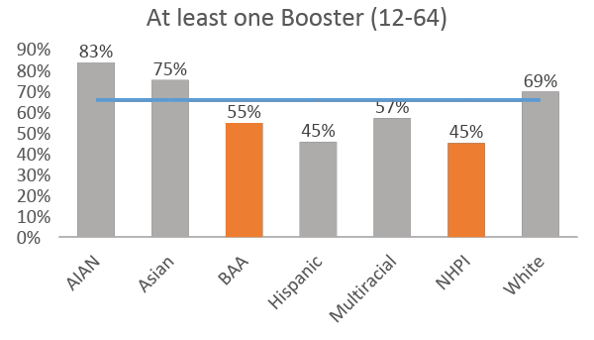
Vaccination rates for 12-64 year-olds
>>
>>
County: 93%
Primary Series Complete rates are very high for all County 12 – 64
BAA and NHPI are below County—still high
County: 66%
Booster rates are moderate for all County 12 – 64
BAA and NHPI are below County
As of 9/29/2022. Bivalent boosters not included.

Slide 8
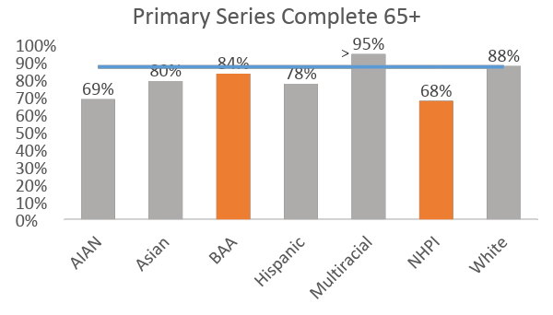
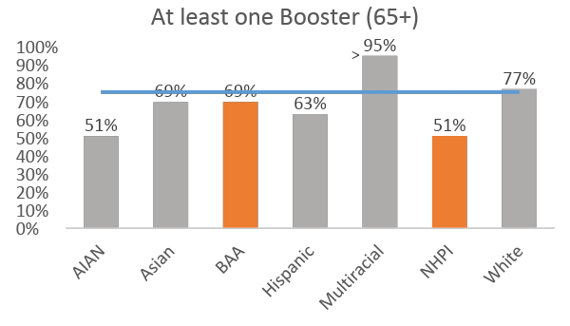
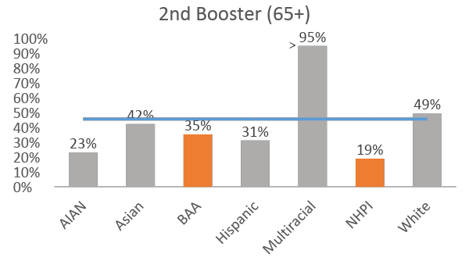
Vaccination rates for 65+ year-olds
>
County: 88%
Primary Series Complete rates are very high for all County 65+
Booster rates are high for all County 65+
2nd Booster rates are low for all County 65+
BAA and NHPI are below County for all
>
>
County: 75%
County: 46%
As of 9/29/2022. Bivalent boosters not included.

Slide 9
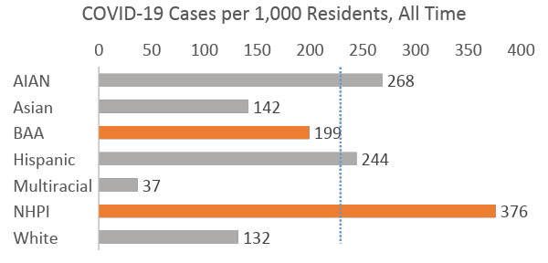
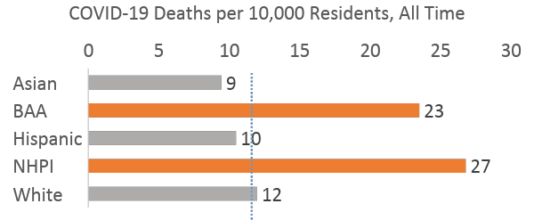
Disparate COVID-19 Case Rates & Death Rates
COVID-19 Cases, All Time
AIAN | 281
Asian | 32689
BAA | 2970
Hispanic | 47768
Multiracial | 1450
NHPI | 3368
White | 37469
County (including Other/ Unknown) | 170620
Higher case rate for NHPI
County: 220
COVID-19 Deaths, All Time
Asian | 218
BAA | 35
Hispanic | 205
NHPI | 24
White | 340
County (including Other/Unknown) | 835
Higher death rate for BAA and NHPI
County: 11
As of 10/6/022.

Slide 10
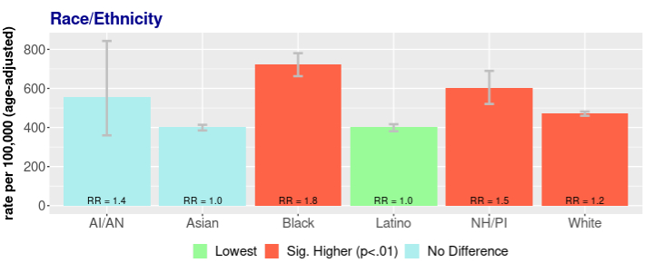
Disparities in Death Rates. ALL CAUSES
Impacts beyond COVID:
Significantly higher Deaths Races (ALL CAUSES) for Black and NHPI
California Community Burden of Disease Engine (CCB), https://skylab.cdph.ca.gov/communityBurden/

Slide 11
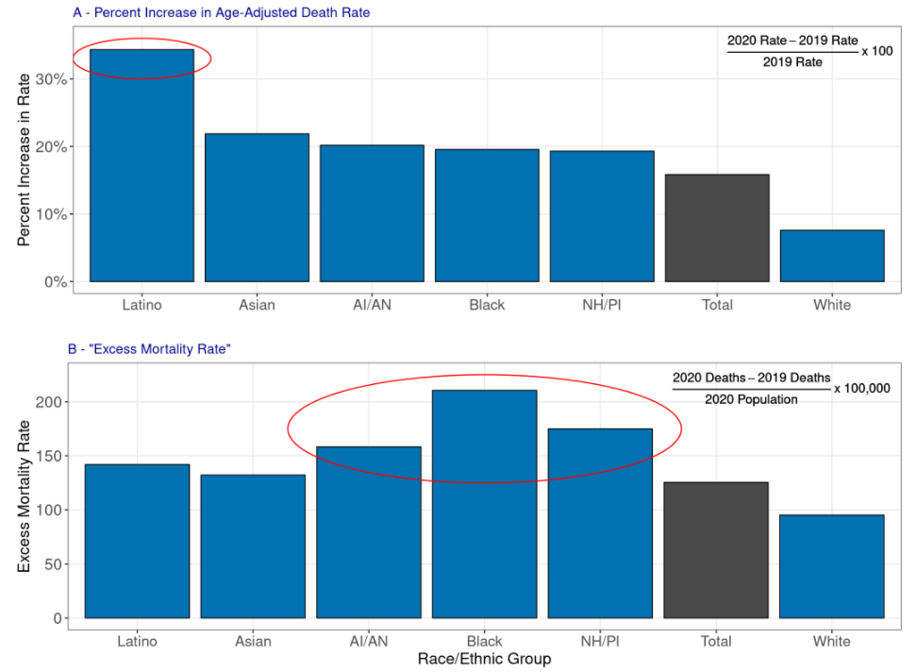
Excess Mortality in CA, 2020 vs. 2019
Multiple ways of looking at Excess Mortality that highlight disparities:
Percent increase in death rate over time.
Increase in number of deaths, divided by the population size.
California Community Burden of Disease Engine (CCB), 2020/2021 Excess Mortality Data Brief. https://skylab.cdph.ca.gov/communityBurden/_w_1d069366/xMDA/2020_Excess_Mortality.html

Slide 12
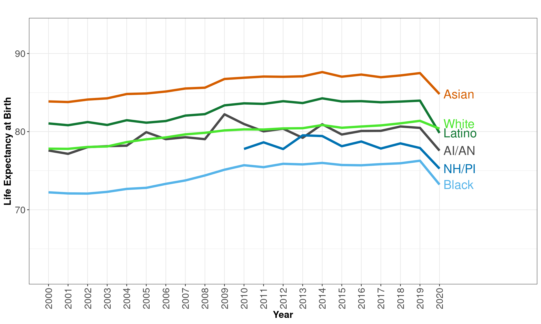
Life Expectancy Trend in CA, 2000 - 2020
Life expectancy at birth (LE) decreased among all groups in California in 2020
California Community Burden of Disease Engine (CCB), 2020/2021 Excess Mortality Data Brief. https://skylab.cdph.ca.gov/communityBurden/_w_1d069366/xMDA/2020_Excess_Mortality.html

Slide 13
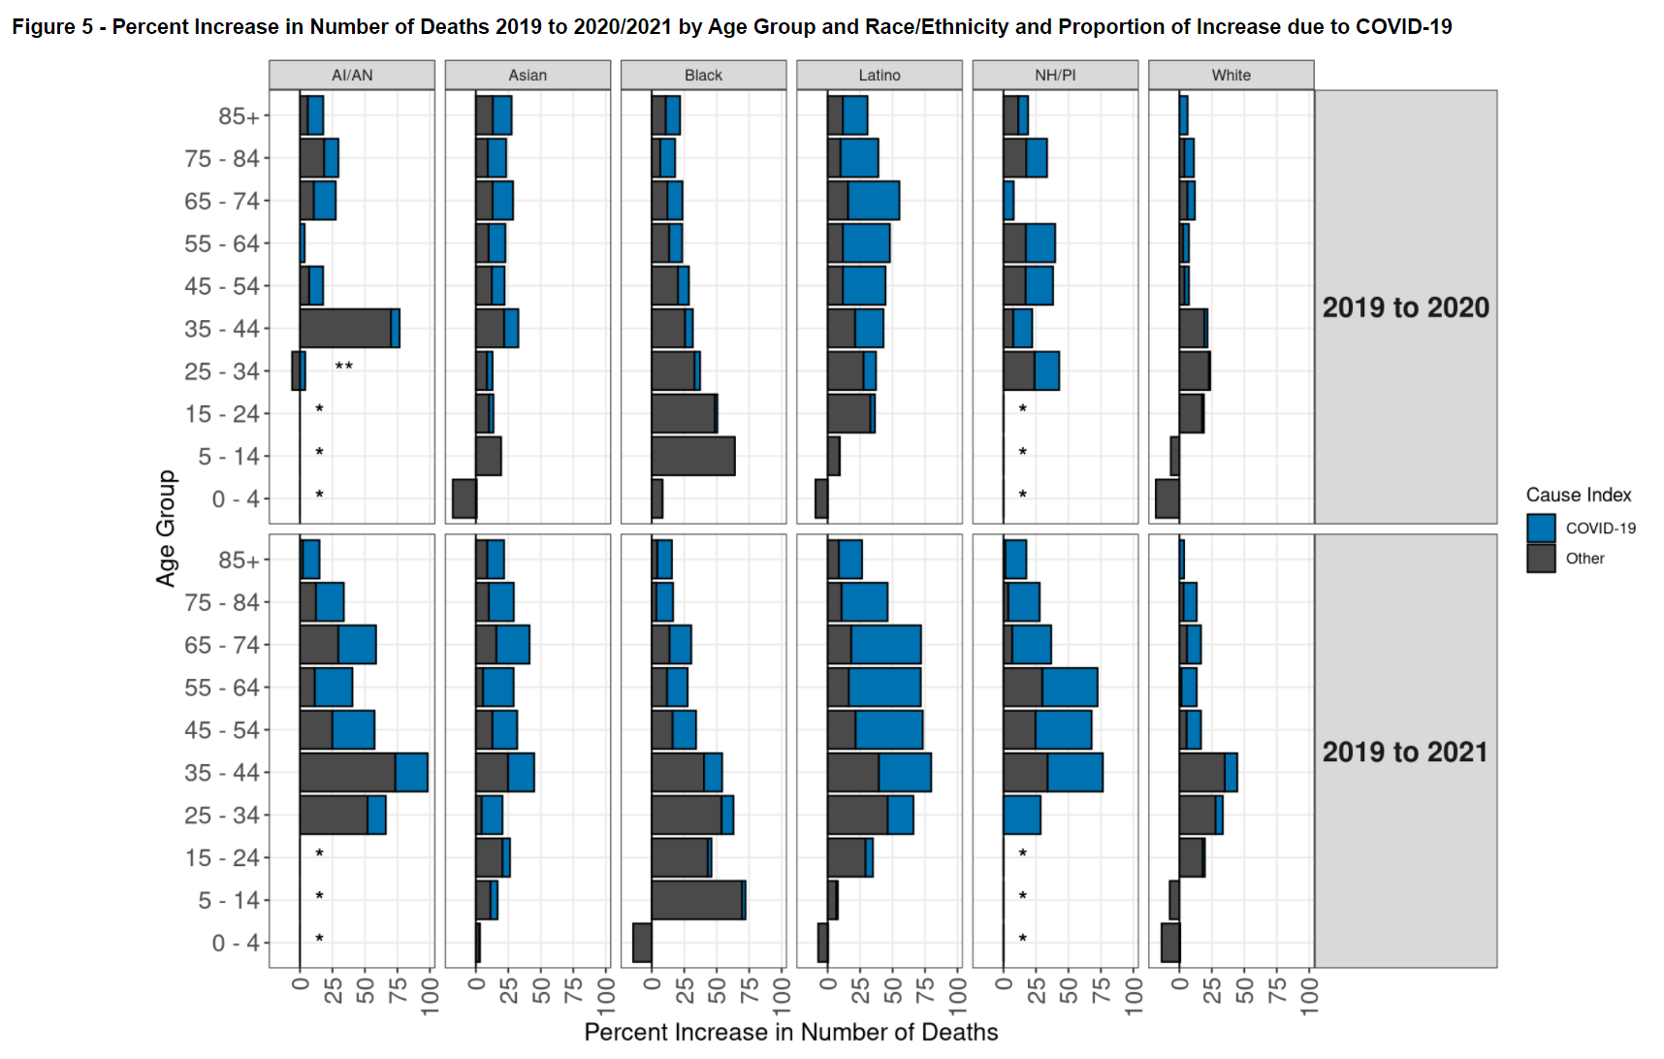
AIAN | Asian | Black | Latino | NHPI | White
COVID-19 was the second leading cause of death in 2020 and the leading cause of death in 2021.
% increase in deaths (from 2019 to 2020/2021) not just due to COVID-19
Large proportion of the Increase in deaths among older persons was largely due to COVID-19.
Increase in deaths among younger persons largely due to other conditions.
2019 to 2020: Large (greater than 50%) increases in deaths among older (65-74) Latinos, younger (5-14 and 15-24) Blacks, and adult (35-44) AI/AN groups.
2019 to 2021: Large (greater than 50%) increases in these groups and several Latino, Black, AI/AN, and NH/PI adult age groups.
California Community Burden of Disease Engine (CCB), 2020/2021 Excess Mortality Data Brief. https://skylab.cdph.ca.gov/communityBurden/_w_1d069366/xMDA/2020_Excess_Mortality.html

Slide 14
Community-Led Input
Community-Led Input Activity
Georgia, Petra, Keirstan
Thrive Alliance

Slide 15
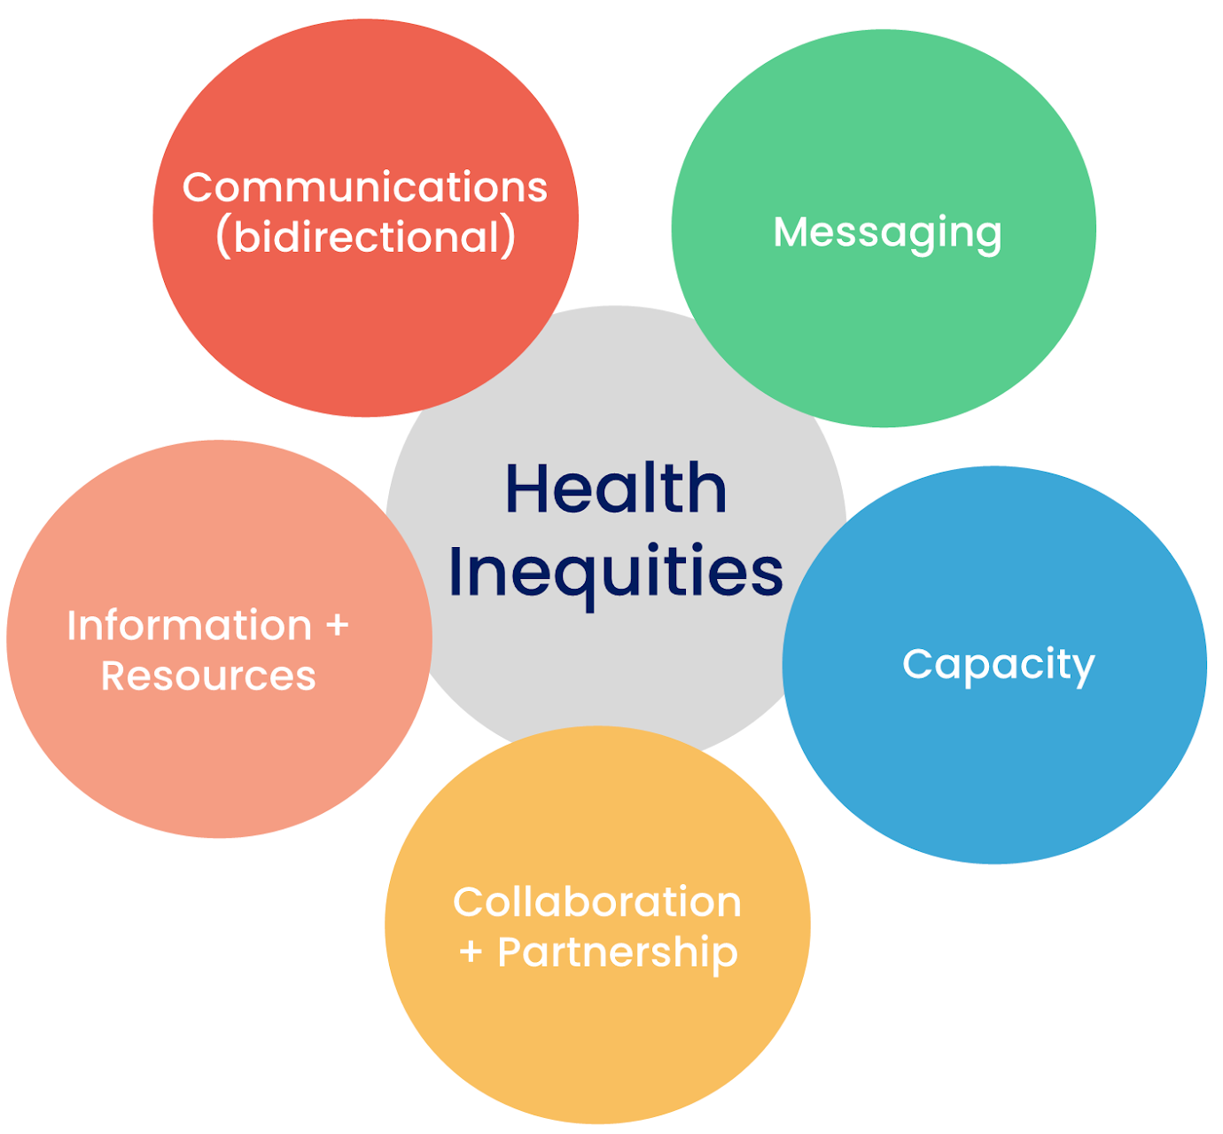
Community Input: COVID-19 Strategies and Priorities
NEXT STEPS

Slide 16
Bridging the Gap
NEXT STEPS
Directions
Please write “PI” for Native Hawaiian/Pacific Islander or “B” for Black/African American on your dots and post-its
Dots
Place 3 green dots for best strategies
Place 3 orange dots for strategies not worth pursuing
Post-It Notes
Add specific comments/suggestions anywhere
Tell us what resources you need to bridge the gap
Add any innovative ideas you have for new ways to reach your community

Slide 17
Thank you! COVID-19 Community Focus Groups
April 1, 2019

Slide 18
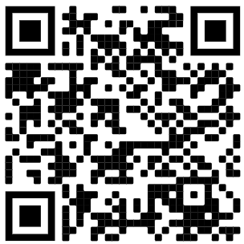
Virtual Focus Group: Thurs, October 27, 10:00 am - 12:00 pm
Register

