Slide 1



We Draw the Lines: What CA Nonprofits and Funders Need to Know About Redistricting

Slide 2
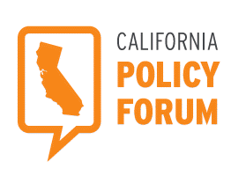
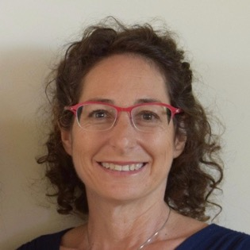
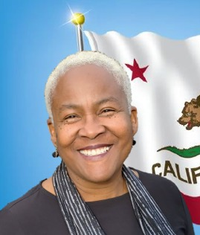
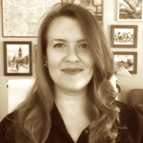
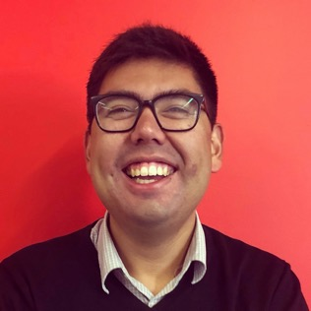
Panelists
Jonathan Mehta Stein Executive Director
California Common Cause
Petra Silton
Director of Advocacy and Education
Thrive Alliance
Commissioner and Pastor Trena Turner
Member of the California Citizens Redistricting Commission
Executive Director of Faith in the Valley
Laura Seaman
CEO
League of California
Community Foundations
Christian Arana, Moderator
Vice President of Policy
Latino Community Foundation

Slide 3
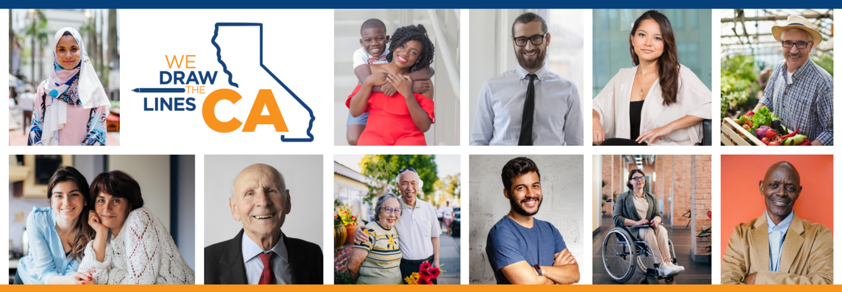
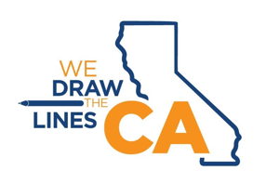
California Redistricting Basics
WeDrawTheLinesCA.org

Slide 4

Reminder—No Public Input Will Be Taken Today
2
Per California Government Code Section 8253(a)(3)--Commission members and staff may not communicate with or receive communications about redistricting matters from anyone outside of a public hearing. Therefore, the Commission will not be taking any public input during these educational presentations.
To provide public input, please visit the Commission's website at: WeDrawTheLinesCA.org.

Slide 5
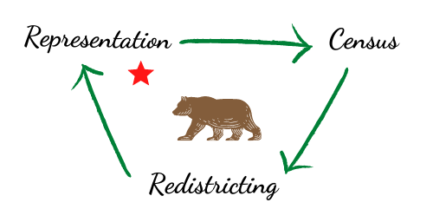
What is Redistricting?
3
Drawing new boundaries that determine which Californians are represented by each electoral district.

Slide 6
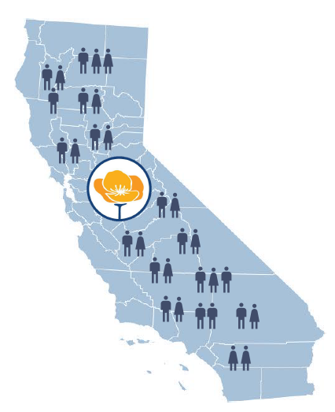
Why We Redraw District Maps
4
Communities change.
People are born, die, and move.
Communities grow and shrink.
Areas where there were once roughly the same number of people become unequal.

Slide 7

Your Voice
5
Why is redistricting important?
Why should you be involved?
Your role in the process
Redistricting has been used at times to exclude communities from political power. By fully participating in and monitoring the upcoming redistricting process, more communities may have a better opportunity to elect candidates of their choice who will voice their needs and interests.

Slide 8
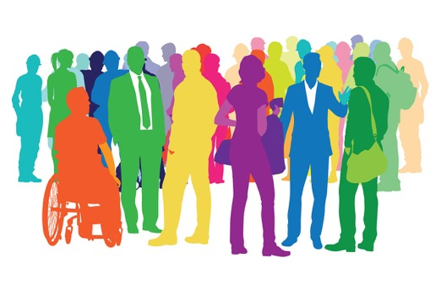


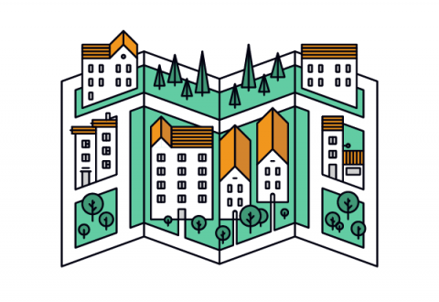


How Redistricting Affects You
6
Power to the People
Champion Your Issues
Funding Priorities
Community Boundaries

Slide 9

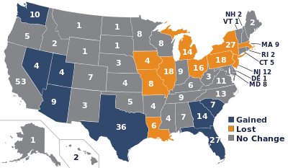

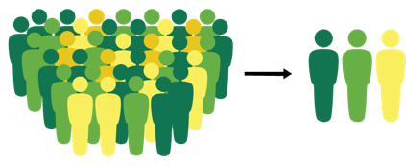
Road to Fair Representation
7
Census—Every ten years the entire U.S. population is counted, and that data is used to draw new maps to account for population shifts across the states and districts.
Reapportionment—The federal reallocation of House seats among the states, done after each national census to ensure seats are held by the states in proportion to the size of their population.
Redistricting—Drawing new boundaries that determine which Californians are represented by each electoral district.
Fair Representation—Historically, legislators have drawn maps that allowed them to choose their constituents rather than enabling constituents to choose their representatives. This former system undermined the concept of fair representation, which is to give people the power to choose their representatives.
+ + =

Slide 10
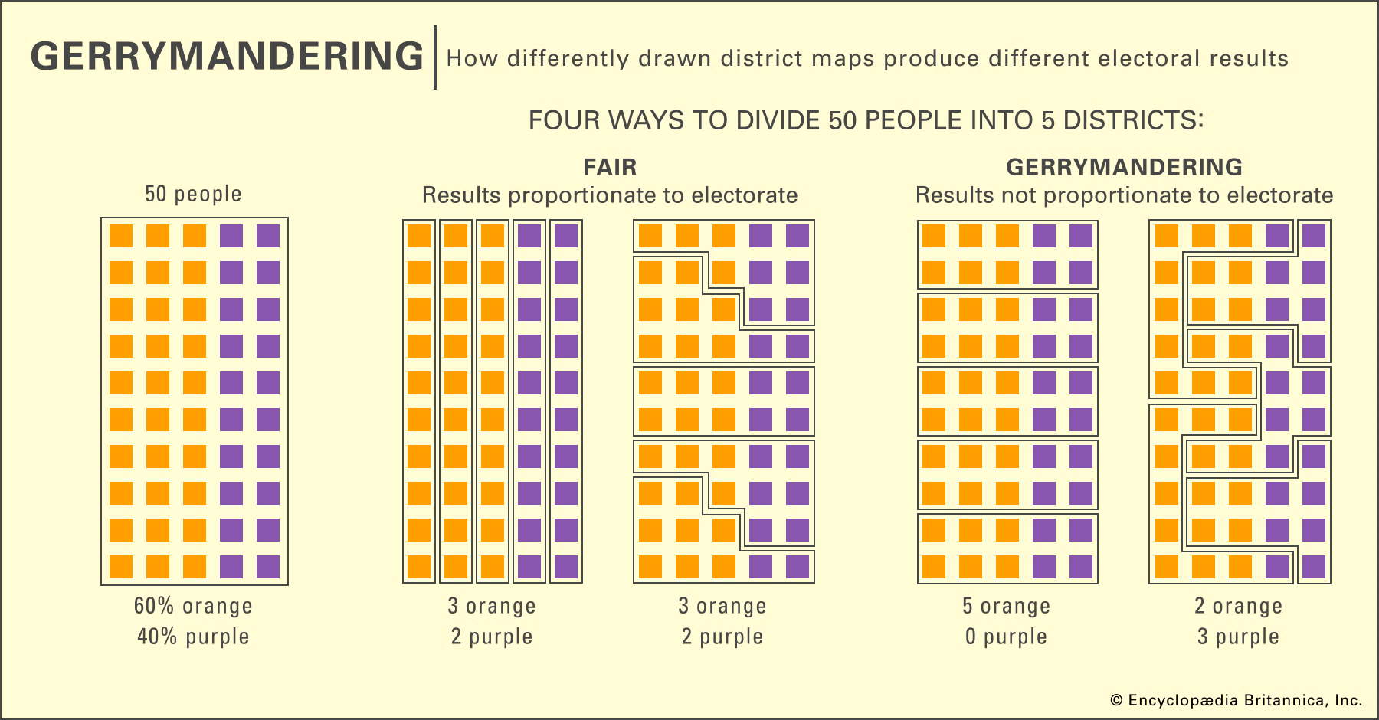
Why Independent Redistricting Matters
8

Slide 11
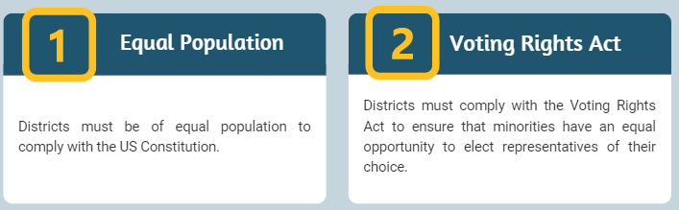
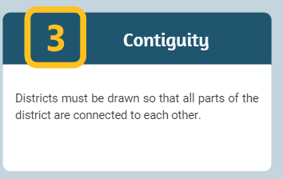
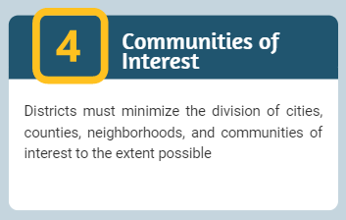
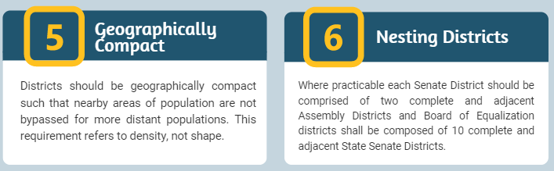
6 Line Drawing Criteria by Order
9
The Commission must follow these weighted criteria in this order when drawing district maps:
In addition, the place of residence of any incumbent or political candidate may not be considered in the creation of a map, and districts may not be drawn for the purpose of favoring or discriminating against an incumbent, political candidate, or political party.

Slide 12






Different Redistricting Efforts
10
State—Congressional, State Senate, State Assembly, and Board of Equalization.
Counties—58 counties, some with their own process.
Cities—482 cities, some with their own process.
School Districts—1037 school districts, some with their own process.
Other Redistricting Efforts—water districts, community college districts, etc.

Slide 13
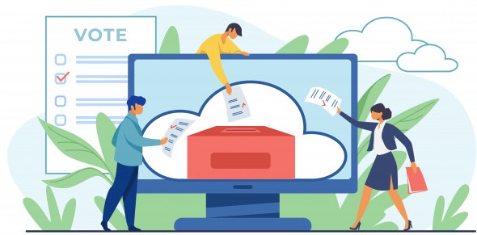
History
11
Prior to 2010—Legislators drew lines, or the court did if the legislature failed to carry out this duty properly
Proposition 11 (2008)—the Voters FIRST Act/We Draw the Lines for State Senate, State Assembly, and Board of Equalization
Proposition 20 (2010)—Added congressional districts
2010 Redistricting Commission
2020 Redistricting Commission
Other States with Independent Commissions—Arizona, Colorado, Idaho, Michigan, Montana and Washington use independent commissions to draw the lines.

Slide 14

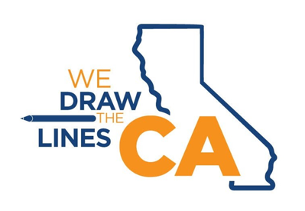
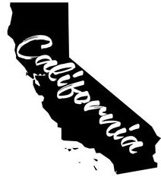

Commissioner Selection
12
Commissioner Applications (Over 20,000 applicants)
Supplemental Applications (2,000)
Interview/Screening Process (120 applicants)
Applicant Pool Sent to Legislature (60 applicants)
Legislative Strikes (12 strikes each party)
Lottery System: First 8
Final 6 Selection

Slide 15

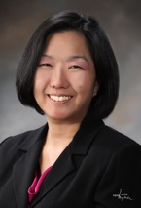
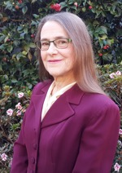
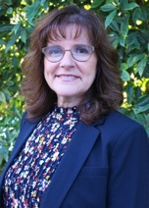
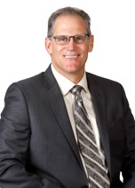
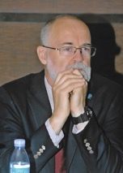
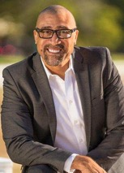
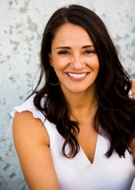
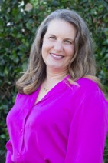
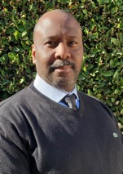
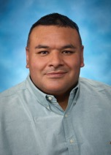
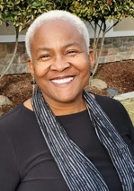
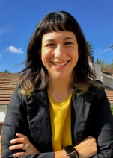
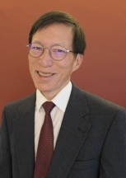
Who we are
13
2020 Commissioners: 14 Members
Isra Ahmad, San Jose, No Party Preference | Sara Sadhwani, La Cañada Flintridge, Democrat
Linda Akutagawa, Huntington Beach, No Party Preference | Patricia S. Sinay, Encinitas, Democrat
Jane Andersen, Berkeley, Republican | Derric Taylor, Los Angeles, Republican
Alicia Fernández, Clarksburg, Republican | Pedro Toledo, Petaluma, No Party Preference
Neal Fornaciari, Tracy, Republican | Trena Turner, Stockton, Democrat
J. Ray Kennedy, Morongo Valley, Democrat | Angela Vázquez, Los Angeles, Democrat
Antonio Le Mons, Studio City, No Party Preference | Russell Yee, Oakland, Republican

Slide 16

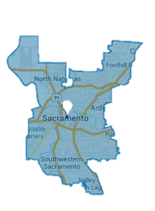
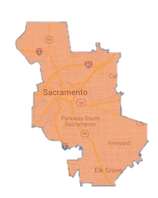
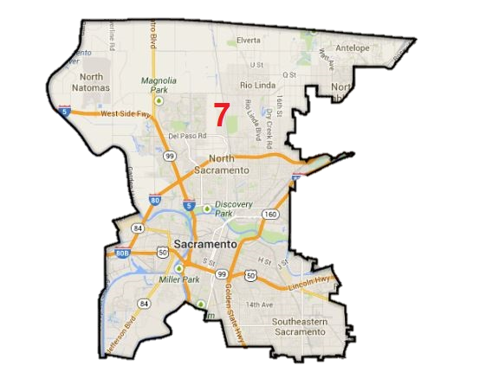
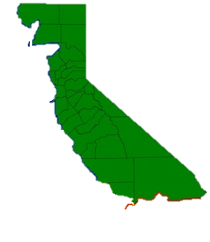
Commissioner Duties
14
Community Outreach/ Public Input Meetings
Engage the public
Collect community input
Hear public testimony
Draw Maps--Draft and final maps for Congress (52), Senate (40), Assembly (80), and Board of Equalization (4)
EXAMPLE: SACRAMENTO
CONGRESS SENATE ASSEMBLY BOE (700,000 people) (931,000 people) (466,000 people) (9 million people)

Slide 17
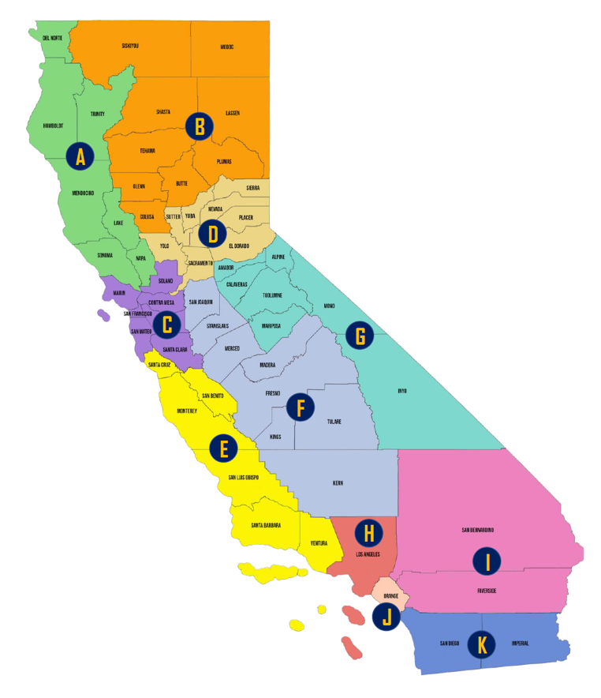
Outreach Zones
15
ZONE | COUNTIES | COMMISSIONERS
A | Del Norte, Humboldt County, Mendocino, Lake, Napa, Sonoma, Trinity | Commissioner Toledo Commissioner Taylor
B | Butte, Colusa, Glenn, Lassen, Modoc, Plumas, Shasta, Siskiyou, Tehama | Commissioner Sinay Commissioner Yee
C | Alameda, Contra Costa, Marin, San Francisco, San Mateo, Santa Clara, Solano | Commissioner Yee Commissioner Toledo
D | El Dorado, Nevada, Placer, Sacramento, Sierra, Sutter, Yolo, Yuba | Commissioner Fernandez Commissioner LeMons
E | Monterey, San Benito, San Luis, Obispo, Santa Barbara, Santa Cruz, Ventura | Commissioner Fornaciari Commissioner Kennedy
F | Fresno, Kern, Kings, Madera, Merced, San Joaquin, Stanislaus, Tulare | Commissioner Turner Commissioner Vazquez
G | Alpine, Amador, Calaveras, Inyo, Mariposa, Mono, Tuolumne | Commissioner Andersen Commissioner Akutagawa
H | Los Angeles | Commissioner Taylor Commissioner Ahmad
I | Riverside, San Bernardino | Commissioner Kennedy Commissioner LeMons
J | Orange | Commissioner Akutagawa Commissioner Sadhwani
K | Imperial, San Diego | Commissioner Sinay Commissioner Ahmad

Slide 18
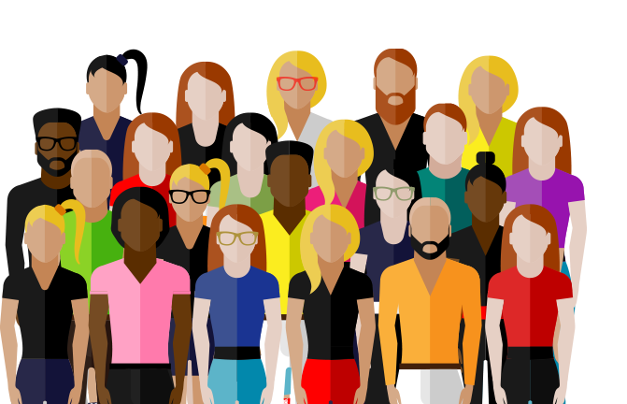
Communities of Interest (COI)
16
Communities of Interest (COI)--A community of interest is a concentrated population which shares common social and economic interests that should be included within a single district for purposes of its effective and fair representation.
Examples include culture, areas in which the people share similar living standards, use the same transportation facilities, have similar work opportunities, or have access to the same media.
People can belong to multiple communities of interest.
Community of Interest is not the same as a district but are key building blocks of districts.

Slide 19

Defining Your Communities
17
Communities of interest can be described by creating maps and telling us about your community.
Oral Testimony—Personal stories are powerful as well as providing historical context.
Written Testimony—A written description can be used to tell your community’s story.
Community Issues—Often communities get involved in redistricting because they feel their issues have not been adequately addressed by their elected representatives. Are there issues your Community of Interest focuses on?
Boundary Maps—Create a map of your neighborhood or area.

Slide 20






Participating in the Process
18
DESCRIBE your community | DRAW your community on a map | SEND your testimony directly to the Commission
Provide your input today at: DrawMyCACommunity.org

Slide 21

Ways to Provide Public Input
19
Communities of Interest (COI) Mapping Tool: DrawMyCACommunity.org
Will also be available in paper form with pre-paid postage.
On Our Website: www.WeDrawTheLinesCA.org, and click on the “Draw My CA Community icon"
By E-mail: VotersFirstAct@crc.ca.gov
By Phone: (916) 323-0323
By Mail: California Citizens Redistricting Commission 721 Capitol Mall, Suite 260 Sacramento, CA 95814
The online COI tool is available in English, Spanish, simplified Chinese, traditional Chinese, Vietnamese, Tagalog, Korean, Armenian, Farsi, Arabic, Russian, Japanese, Punjabi, and Khmer. Tutorials are also available in those languages.

Slide 22

Language Access
20
Translation of Materials: Fact Sheet, Flyer, FAQs, California Redistricting Basics Presentation
Languages—Spanish, simplified Chinese, traditional Chinese, Vietnamese, Tagalog, Korean, Armenian, Farsi, Arabic, Russian, Japanese, Punjabi, and Khmer.
Interpretation of public comment at CRC business meetings may be provided with five days advance notice.
Written public input can be sent to the CRC in any format and will be translated into English.
The Commission will translate non-English language inputs from the COI tool into English.
If you need an interpreter to provide input during a meeting, we ask that you notify the Commission five business days prior to a meeting to request interpreter services. The Commission will attempt to contract with an interpreter in the requested language.

Slide 23

CA Supreme Court Ruling
21
Legislature of CA v Alex Padilla
S262530 July 17, 2020
The California Supreme Court ruled on July 17, 2020 that the Commission should have until December 15, 2021 to submit its maps to the California Secretary of State due to the delay in release of census results. If census results are received after July 31, 2021, the Commission’s deadline will be adjusted accordingly.

Slide 24

Timeline
22
February-May, 2021: Education Presentations (California Redistricting Basics)
April 2021: Reapportionment Data
June-August, 2021: Public Input Meetings (COI)
August 15-30, 2021: Census Data Expected to the State
September 30-October 31, 2021: Census Data Expected to the Commission
October-December, 2021: Public Input Meetings/Line Drawing Sessions (Pre district maps)
November-December, 2021: Draft District Maps Released
December 2021-January 2022: Public Input Meetings/Line Drawing Sessions
December 2021-February 2022: District Maps Released
December 2021-February 2022: Final District Maps to Secretary of State
*Dates will be updated on our website once the census data are received and the Commission
adopts the final schedule.

Slide 25
Reminder—No Public Input Will Be Taken Today
23
Per California Government Code Section 8253(a)(3)–
Commission members and staff may not communicate with or receive communications about redistricting matters from anyone outside of a public hearing. Therefore, the Commission will not be taking any public input during these educational presentations.
To provide public input, please visit the Commission's website at: WeDrawTheLinesCA.org.

Slide 26



Contact Us
24
To request an informational session, please contact the Commission.
California Citizens Redistricting Commission 721 Capitol Mall, Suite 260 Sacramento, CA 95814 (916) 323-0323
Marcy.Kaplan@crc.ca.gov
For more information about the Commission, please visit: WeDrawTheLinesCA.org
Social Media Handles: @WeDrawTheLinesCA

Slide 27

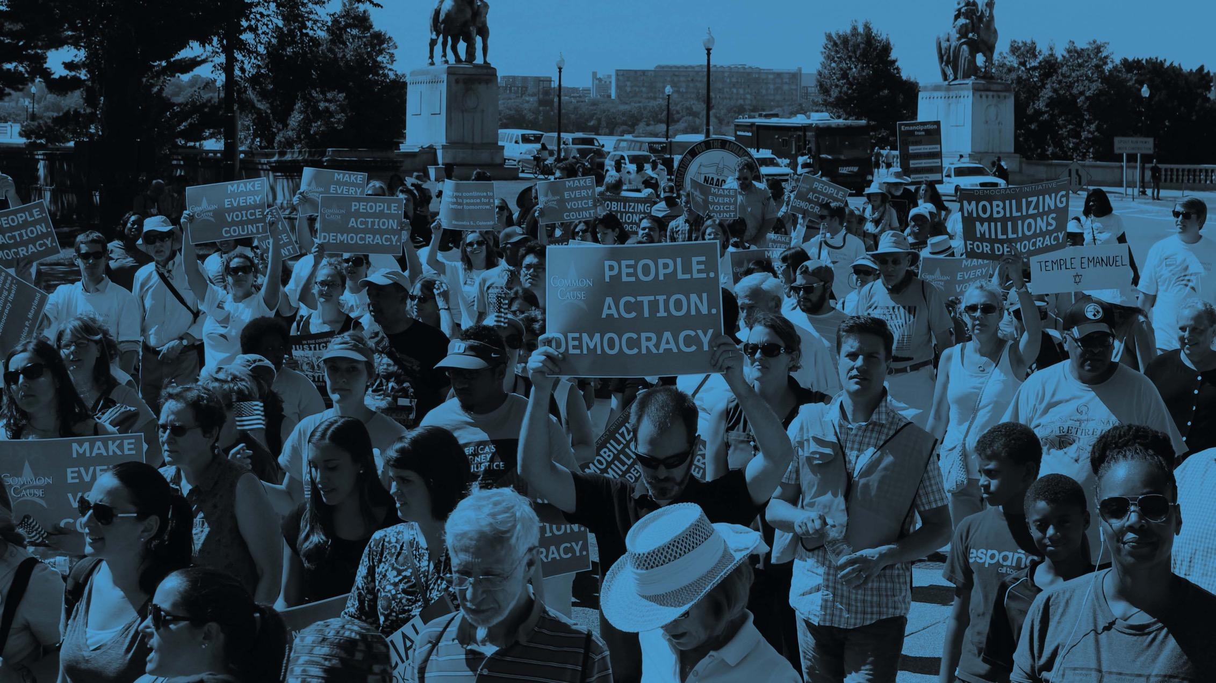

Redistricting 2021: Opportunities at the Local Level
Kathay Feng – kfeng@commoncause.org

Slide 28
Why Does Local Redistricting Matter?

Slide 29
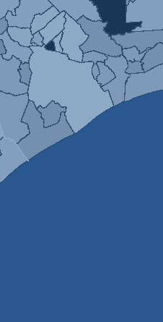
After thousands of hours worked and millions of dollars spent on Census 2020…
…redistricting is where Census 2020 meets power-building.

Slide 30

Local Redistricting Determines Who Holds Power In Our Communities
Local redistricting determines which local communities have voting strength and can elect representation
Health equity, environmental justice, policing and law enforcement, housing – these are issues governed at the city and county level
Census determines whether your jurisdiction and region get their fair share of federal resources, but it is local lawmakers who determine how those federal resources are spent
Kathay Feng – kfeng@commoncause.org
Notes:
Local redistricting determines which communities are empowered and which are disempowered.
If a community is kept whole in a single district, it can control the outcome of the election in that district. It can elect representation that understands the communities needs and will fight for that community, maybe even comes from the community and looks like the community.
If a community is cut up, its voting strength is diluted. It can’t influence the outcome of an election in any jurisdiction. [click]
This has a wide range of consequences. Health equity, environmental justice, policing and law enforcement, housing affordability, quality of schools – these are local issues controlled by local decisionmakers. [click]
It is also the case that while Census determines if your community gets its fair share of federal resources, it is local decisionmakers who determine how that money is spent. As a result, tocal redistricting determines which communities are invested in and which are chronically not invested in. [click]
Lastly, local redistricting helps determine who gets elected at the local level, which forms the bench for future leaders at the state and federal levels.

Slide 31
Local Redistricting Determines Who Holds Power In Our Communities
Local redistricting controls the entry point into politics and thus determines our future leaders at higher levels
Local redistricting determines which communities decisionmakers are responsive to and accountable to
Example: Watts in 2003
Kathay Feng – kfeng@commoncause.org
Notes:
Local redistricting determines which communities are empowered and which are disempowered.
If a community is kept whole in a single district, it can control the outcome of the election in that district. It can elect representation that understands the communities needs and will fight for that community, maybe even comes from the community and looks like the community.
If a community is cut up, its voting strength is diluted. It can’t influence the outcome of an election in any jurisdiction. [click]
This has a wide range of consequences. Health equity, environmental justice, policing and law enforcement, housing affordability, quality of schools – these are local issues controlled by local decisionmakers. [click]
It is also the case that while Census determines if your community gets its fair share of federal resources, it is local decisionmakers who determine how that money is spent. As a result, tocal redistricting determines which communities are invested in and which are chronically not invested in. [click]
Lastly, local redistricting helps determine who gets elected at the local level, which forms the bench for future leaders at the state and federal levels.

Slide 32
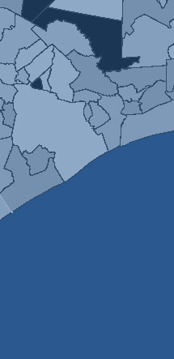
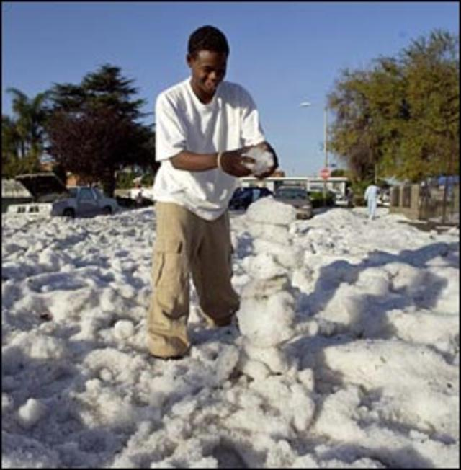
In a time of need, Watts was ignored.
Photo credit: AP/CBS News
Notes:
On November 12, 2003, a freak storm dumped over 5 inches of rain and hail on Watts, overwhelming storm drains and flooding the community. About 150 buildings and homes were heavily damaged, 50,000 people lost power, and 6,000 people sought aid from the county’s emergency center. Firefighters rescued about 100 people from waistdeep water and snow.
Many people had lost everything. However, the government was slow to aid the people. FEMA refused to act when then-Governor Gray Davis declared a state of emergency (six days after the flood).

Slide 33
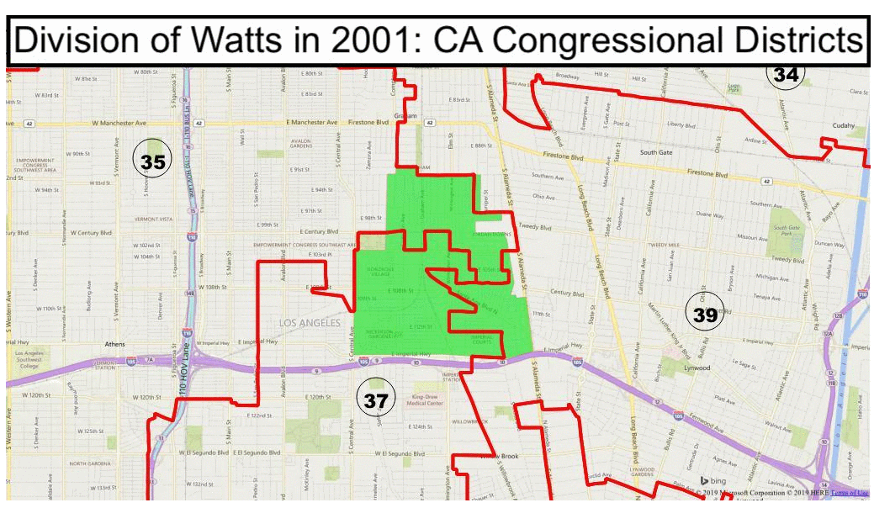
In 2001, Watts was split by incumbents into 3 districts at the Congressional level.
Why? Because the Watts neighborhood was split by district lines.
Notes:
In 2001, Watts was split by incumbents into three districts at the congressional and state senate level.

Slide 34
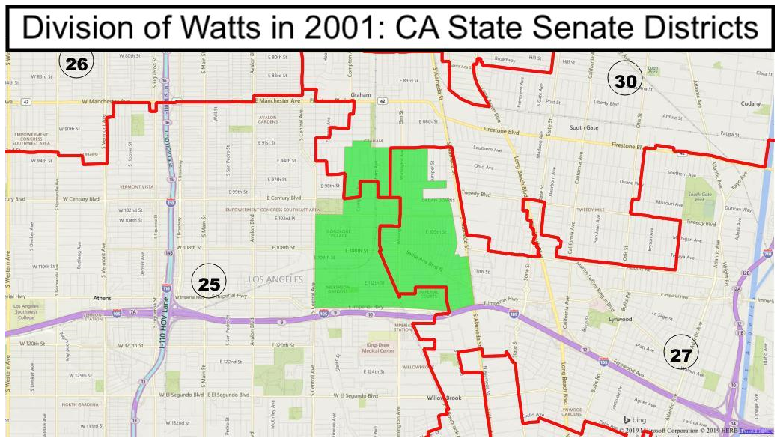
In 2001, Watts was also split by incumbents into 3 districts at the State Senate level.
Why? Because the Watts neighborhood was split by district lines.

Slide 35
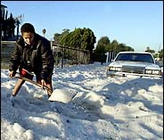
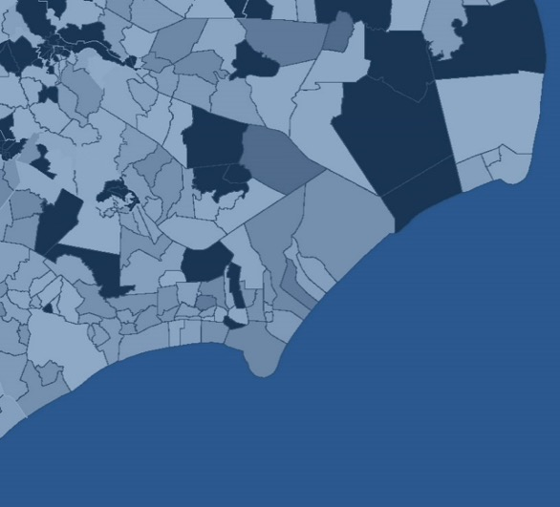

“At the time of the 2003 flood, I remember our office trying to be very responsive, but there was a lot of ping-ponging of constituents between elected representatives.
Watts is cut into three different Congressional and state Senate districts. Residents who live on the same street may live in different districts. There was a lot of unnecessary frustration for constituents during a difficult time.
This would have never happened if all of Watts belonged to one district.”
- Romulo Rivera, former Congressional staffer
Notes:
As this quote from a former congressional staffer indicates, Watts residents struggled to get the attention of elected officials because none of them felt responsible for the care of that community. [read some portion of the quote]

Slide 36
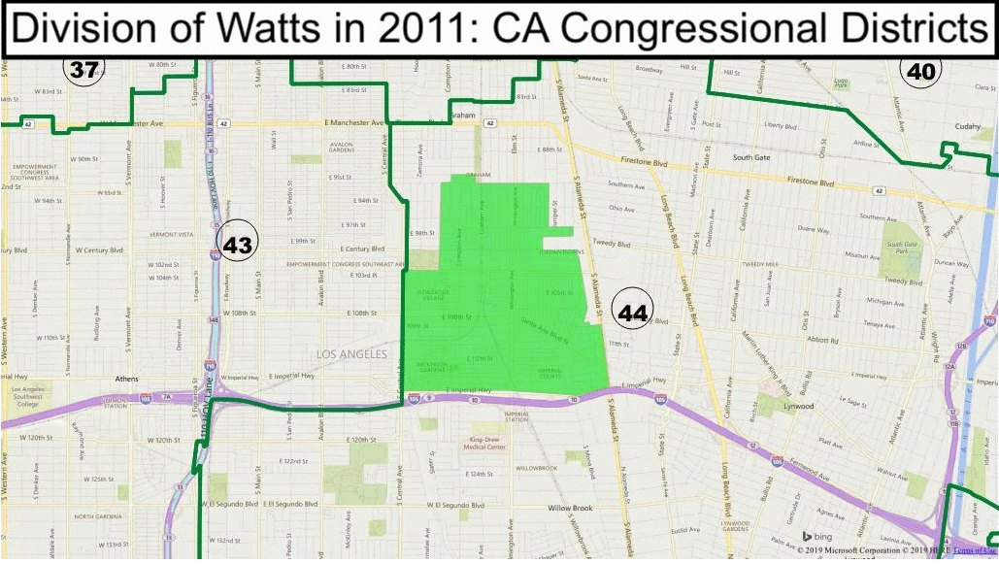
In 2011, Watts leaders united to testify before the CA Citizens Redistricting Commission.
This was the end result for congressional districts.
Redistricting with community input makes a difference.
Notes:
After 2011, after leaders united to testify about Watts before the CA Citizens Commission, Watts was made whole. (P.S. Nanette Barragán is the current congressional member representing CD 44, first Latina, in a district that flipped from Republican to Democrat in 2012)

Slide 37
How Do We Engage Local Communities?

Slide 38
Gathering COI
Help community members understand what “COI” is
Kathay Feng – kfeng@commoncause.org

Slide 39
Detour: Defining COI
“A ‘community of interest’ is a population that shares common social or economic interests that should be included within a single district for purposes of its effective and fair representation. Communities of interest do not include relationships with political parties, incumbents, or political candidates.”
Kathay Feng – kfeng@commoncause.org

Slide 40
Detour: Defining COI
Okay but what is a community interest really?
Kathay Feng – kfeng@commoncause.org
Notes:
A communities of interest is a group or network that shares interests, views, cultures, histories, languages, and values. The following elements help define communities of interest:
❖ Shared interests in schools, housing, crime, transit, health conditions, land use, environmental conditions, and/or other issues;
❖ common social and civic networks, including churches, temples, nonprofits, community groups, and community centers, and shared use of community spaces, like parks and shopping centers;
❖ racial and ethnic compositions, cultural identities, language communities;
❖ similar socio-economic status, including but not limited to income, home-ownership, and education levels.
You may be thinking to yourself, I still don’t get it. That isn’t very clear. Could a community of interest by…. Anything? Let’s be more concrete. The historic LGBT neighborhood in town might be a community of interest. The portion of town that is disconnected from the rest of the town by a major highway and suffers from lower property values and a lack of services might be a community of interest. A portion of the county that has a highly rural lifestyle or agricultural economy, distinct from the county’s population centers, might be a community of interest. The neighborhood that has lots of limited-English speaking immigrant families that are reliant on English-language learning programs in schools and need in-language social services might be a COI.
The presentations coming after me will provide demonstrations on how to map your COI using simple online mapping tools.
Commoncause.org/localredistricting2021 for an easy-to-use template for giving community of interest testimony.

Slide 41
Gathering COI
Help community members understand what “COI” is
Community meetings, workshops, zooms
Help them identify their COI
Community conversations, paper maps in small groups, projected map in larger group settings
Kathay Feng – kfeng@commoncause.org

Slide 42
Gathering COI
Help them draft and prep their COI testimony
Speakers’ trainings, Common Cause template
Provide mapping support
Verbal testimony strengthened by COI map, single-district map, or full district map
Districtr and other online mapping tools
Kathay Feng – kfeng@commoncause.org

Slide 43
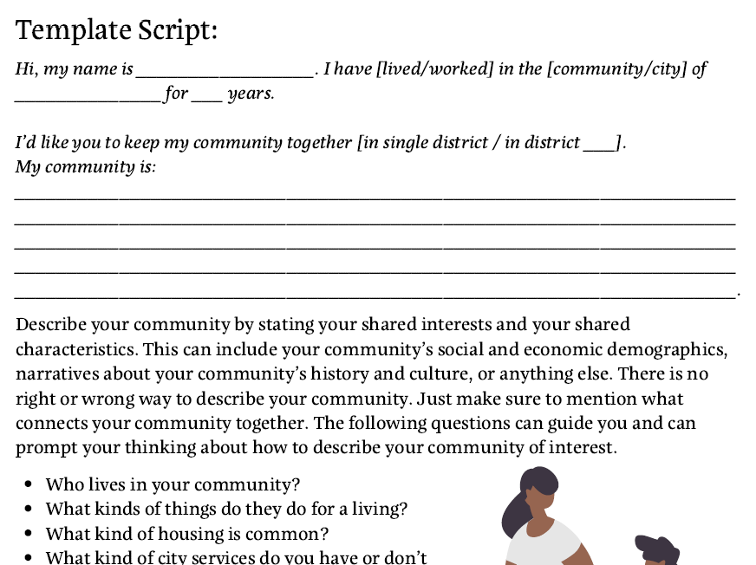
Notes:
Template doc is available at Commoncause.org/localredistricting2021.

Slide 44
For More Information…
For info on redistricting law…
For info on process requirements, i.e. public education, language access, number of hearings, etc….
For redistricting best practices...
For a template for community of interest testimony…
For sample outreach materials and social media…
Kathay Feng – kfeng@commoncause.org

Slide 45
For More Information…
Commoncause.org/localredistricting2021/
Email us: RedistrictingCA@commoncause.org
Kathay Feng – kfeng@commoncause.org

Slide 46






Policy & Advocacy
Cross-Sector Collaboration
Nonprofit Capacity Building

Slide 47

San Mateo County’s elected officials are overwhelmingly white and male. The Bay Area as a whole is 60 percent people of color, but people of color hold just 34 percent of top local elected offices.
(source: Bay Area Equity Atlas)

Slide 48

Redistricting: A Once in a Decade Opportunity
Independent Redistricting Commission: The Next Step to Ensure Fair and Equitable Redistricting in San Mateo
District Lines and Political Power: State Level Redistricting
Thrive defined its role as educating, providing support, and advocating for the most fair and inclusive process.

Slide 49





Thank You to Our Community Partners

Slide 50


“Philanthropy makes good decisions when they have good information. Thrive is able to talk to many players at once and can synthesize needs and/or opportunities for us to act on. Thrive took the lead in getting folks together because they saw the importance of redistricting and that action needed to be taken. Partners who are quick to respond and quick to activate are invaluable. We have no time to waste, so clear asks from Thrive have been key.”
Jose Santos, Grove Foundation
“Government partners like San Mateo County are an important part of the funding picture. Foundations can be helpful partners not just for funding, but have a range of ways they can support nonprofits, and lobbying is one component of that.”
Jack Mahoney, Silicon Valley Community Foundation

Slide 51


Visit Our Webpage!

Slide 52

Special thanks to our speakers!
Speakers:
Commissioner and Pastor Trena Turner, Member of the California Citizens Redistricting Commission and Executive Director of Faith in the Valley
Jonathan Mehta Stein, Executive Director of California Common Cause
Petra Silton, Director of Advocacy and Education at Thrive Alliance
Christian Arana, Vice President of Policy, Latino Community Foundation (moderator)
Laura Seaman, CEO, League of California Community Foundations (host)
With thanks to our captioner and technical support team, Henry Duong and Christine Metropoulos
You will get the recording via email by the end of the day Thursday (6/17)

